Slide 1
EULAR Recommendations/Points to Consider Slide Set template
Slide set should, if possible, not exceed 20 Slides
Please submit slide set along with final manuscript to the EULAR Secretariat for review before manuscript submission to any journal

Slide 2
Recommendation title

Slide 3
Slide 1: Target population/question

Slide 4
Slide 2: Methods/methodological approach
Methods: According to the EULAR Standardized Operating Procedures
Consensual approach
Systematic literature research
Consensual approach
FINAL Recommendations

Slide 5
Slides 3-4: Overarching principles

Slide 6
Slides 5-15: Individual Recommendations

Slide 7
Slide 16: Summary Table Oxford Level of Evidence

Slide 8
Slides 17-18: Summary of Recommendations in bullet point format
[EULAR Office will add link of recommendation once available online on BMJ portal.]

Slide 9
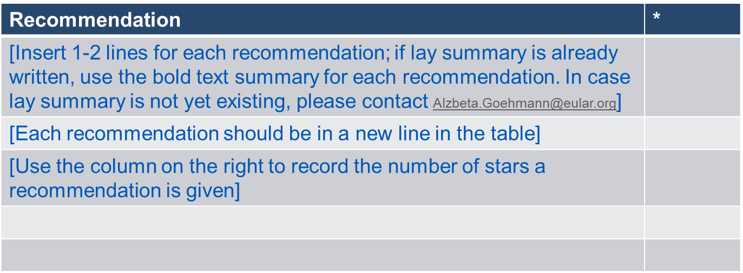
Slides 19-20: Summary of Recommendations in lay format
1 star (*) means it is a weak recommendation with limited scientific evidence; 2 stars (**) means it is a weak recommendation with some scientific evidence; 3 stars (***) means it is a strong recommendation with quite a lot of scientific evidence; 4 stars (****) means it is a strong recommendation supported with a lot of scientific evidence.
Recommendations with just 1 or 2 stars are based mainly on expert opinion and not backed up by appropriate clinical studies, but may be as important as those with 3 and 4 stars.
Read the full lay summary (add hyperlink if provided)

Slide 10
Slide 21: Acknowledgements

