Slide 1

EULAR recommendations for the health professional’s approach to pain management in inflammatory arthritis and osteoarthritis
EULAR HP pain management task force (HPR029)

Slide 2

Background
In Paris (2014), a eular health professional & ARHP steering group concluded that…
Health professionals should have knowledge and skills to offer the first principles of assessment and management of pain
Funded by eular, a task force was established

Slide 3
Task force: varied people
Task force: varied countries
Task force: varied professions/roles
Pernilla Åsenlöf Sweden physiotherapist
Stefan Bergman Sweden general practitioner
Susana Capela Portugal rheumatologist
Robin Christensen Denmark epidemiologist
César Fernández de las Peñas Spain physiotherapist
Rinie Geenen Netherlands project lead
Afton Hassett USA psychologist
Karen Huisinga USA nurse practitioner
Mai Elin Husebø Norway nurse
Albère Köke Netherlands physiotherapist
Cécile Overman Netherlands research fellow
Zoe Paskins United Kingdom rheumatologist
Irene Pitsilidou Cypre patient representative
Sarah Ryan United Kingdom nurse
Carine Savel France nurse
Guy Severijns Belgium patient representative
Michaela Stoffer Austria occupational therapist
Johan Vlaeyen Belgium psychologist
Pernilla Åsenlöf Sweden physiotherapist
Stefan Bergman Sweden general practitioner
Susana Capela Portugal rheumatologist
Robin Christensen Denmark epidemiologist
César Fernández de las Peñas Spain physiotherapist
Rinie Geenen Netherlands project lead
Afton Hassett USA psychologist
Karen Huisinga USA nurse practitioner
Mai Elin Husebø Norway nurse
Albère Köke Netherlands physiotherapist
Cécile Overman Netherlands research fellow
Zoe Paskins United Kingdom rheumatologist
Irene Pitsilidou Cypre patient representative
Sarah Ryan United Kingdom nurse
Carine Savel France nurse
Guy Severijns Belgium patient representative
Michaela Stoffer Austria occupational therapist
Johan Vlaeyen Belgium psychologist
Pernilla Åsenlöf Sweden physiotherapist
Stefan Bergman Sweden general practitioner
Susana Capela Portugal rheumatologist
Robin Christensen Denmark epidemiologist
César Fernández de las Peñas Spain physiotherapist
Rinie Geenen Netherlands project lead
Afton Hassett USA psychologist
Karen Huisinga USA nurse practitioner
Mai Elin Husebø Norway nurse
Albère Köke Netherlands physiotherapist
Cécile Overman Netherlands research fellow
Zoe Paskins United Kingdom rheumatologist
Irene Pitsilidou Cypre patient representative
Sarah Ryan United Kingdom nurse
Carine Savel France nurse
Guy Severijns Belgium patient representative
Michaela Stoffer Austria occupational therapist
Johan Vlaeyen Belgium psychologist

Slide 4
Objective of the task force
To identify the scientific evidence associated with the benefits of the health professional approach to pain management for people with inflammatory arthritis (IA)* and osteoarthritis (OA).
To provide recommendations that enable health professionals in rheumatology to provide knowledgeable pain management support for people with IA and OA.
*
rheumatoid arthritis, spondyloarthropathies, psoriatric arthritis

Slide 5
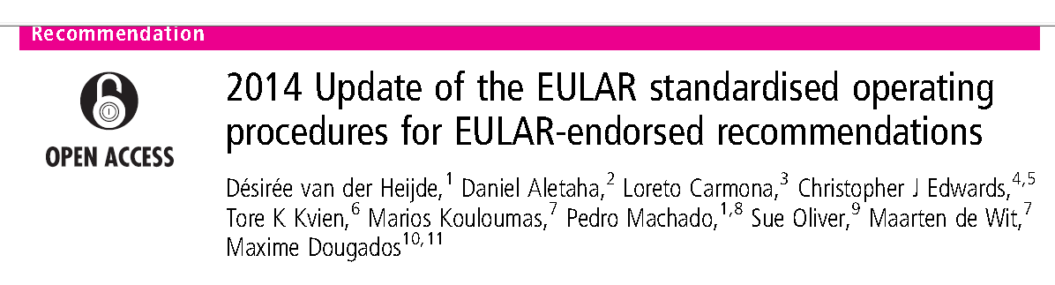
Methods
Standardised operating procedures for eular-endorsed recommendations (Van der Heijde et al. Ann Rheum Dis 2015;74:8-13).
This involves a combination of systematic literature review (Cécile Overman) and clinical expertise (task force).

Slide 6
Scope as defined by task force
Target users
Health professionals in the field of rheumatology, including rheumatologists.
Target population
Patients with osteoarthritis and patients with inflammatory arthritis (rheumatoid arthritis, spondyloarthropathies, and psoriatic arthritis).
Primary outcome in systematic literature review
Pain (however, the outcome of pain management also includes functioning and well-being)

Slide 7
Systematic literature review
Bibliographic databases
Cochrane, Embase, PsycINFo, PubMed, Scopus, Web of Science
Target population
Diseases of interest in the title, word ‘pain’ and a word referring to a mode of intervention or care in the title, abstract, or key words
The search was limited to:
Systematic reviews, meta-analyses, (practice) guidelines and recommendations

Slide 8
Studies found in multiple bibliographic systems using specified keywords (n = 2914)
Excluded (n = 1345)
Duplicates
Titles and abstracts screened (n = 1569)
Excluded (n = 1118)
Not meeting inclusion criteria
Contents of management specified (n = 451)
Excluded (n = 237)
Pharmacological, alternative medication & nutraceuticals, and surgical treatments
Searched for full texts
(n = 214)
Exclude (n = 17)
No full text available
Full text obtained
(n = 197)
Excluded (n = 13)
Not meeting inclusion criteria
Included in systematic literature review
(n = 184)

Slide 9
Overarching principles
Patient-centered framework
Biopsychosocial perspective
Knowledge of inflammatory arthritis and osteoarthritis
Differentiate localized and generalized pain
Assessment
Patients’ needs, preferences, priorities
Pain characteristics
Previous and ongoing pain treatments
Inflammation and joint damage
Pain-related (biopsychosocial) factors that might need attention
Management
Personalized pain management plan including one or more management options
(shared decision making, stepped approach)
Education
Management options
Multidisciplinary treatment
Physical activity and exercise
Aids and assistive devices
Psychological and social interventions
Sleep
hygiene
practices
Weight management
Pharmacol. & joint-specific management

Slide 10
Overarching principles
Patient-centered framework
Biopsychosocial perspective
Knowledge of inflammatory arthritis and osteoarthritis
Differentiate localized and generalized pain
Assessment
Patients’ needs, preferences, priorities
Pain characteristics
Previous and ongoing pain treatments
Inflammation and joint damage
Pain-related (biopsychosocial) factors that might need attention
Management
Personalized pain management plan including one or more management options
(shared decision making, stepped approach)
Education
Management options
Multidisciplinary treatment
Physical activity and exercise
Aids and assistive devices
Psychological and social interventions
Sleep
hygiene
practices
Weight management
Pharmacol. & joint-specific management

Slide 11
Overarching principle 1
The health professional is guided by a patient-centered framework throughout the assessment and management process.
Patient-centered care
is respectful of and responsive to individual patient preferences, needs and values, and ensuring that patient values guide clinical decisions (Institute of medicine, 2001).

Slide 12

Overarching principle 2
The health professional understands that (any type of) pain encompasses multiple and mutually interacting biological, psychological and social components

Slide 13
Overarching principle 2
Pain severity
Inflammation and joint damage
Neurophysiological processes
Physical (dis)ability
Psychological vulnerabilities and resilience
Social factors
Sleep quality
Obesity

Slide 14
Overarching principle 3
The health professional has basic knowledge of the pathology, treatment, and sequelae of inflammatory arthritis and osteoarthritis.

Slide 15
Overarching principle 4
The health professional is able to differentiate between localized and “centralized” pain and is aware that these types of pain may coexist.

Slide 16
Overarching principles
level of agreement
(0 = completely disagree, 10 = completey agree)
9.9
Patient-centered framework
b. Knowledge of inflammatory
arthritis and osteoarthritis
9.8
8.9
c. Differentiate localized and
generalized pain
9.7
d. Biopsychosocial perspective

Slide 17
Overarching principles
Patient-centered framework
Biopsychosocial perspective
Knowledge of inflammatory arthritis and osteoarthritis
Differentiate localized and generalized pain
Assessment
Patients’ needs, preferences, priorities
Pain characteristics
Previous and ongoing pain treatments
Inflammation and joint damage
Pain-related (biopsychosocial) factors that might need attention
Management
Personalized pain management plan including one or more management options
(shared decision making, stepped approach)
Education
Management options
Multidisciplinary treatment
Physical activity and exercise
Aids and assistive devices
Psychological and social interventions
Sleep
hygiene
practices
Weight management
Pharmacol. & joint-specific management

Slide 18

Assessment 1
Use a patient-centered approach to assess…
Patient’s needs, preferences, and priorities regarding pain management
Patient’s priority activities, values and goals in daily life.
?

Slide 19
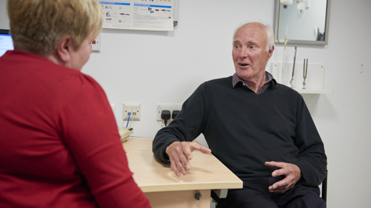
Assessment 2
Use a patient-centered approach to assess…
…the patient’s pain characteristics including intensity, type, spread, and quality.

Slide 20

Assessment 3
Use a patient-centered approach to assess…
…previous and ongoing pain treatments and the efficacy of these treatments

Slide 21

Assessment 4
Use a patient-centered approach to assess…
…current inflammation and joint damage as sources of pain, and whether these are adequately treated.

Slide 22
Assessment 5
Use a patient-centered approach to assess pain-related (biopsychosocial) factors that may be important:
the nature and extent of pain-related disability.
beliefs and emotions about pain and pain-related disability.
social influences related to pain and its consequences.
sleep problems.
obesity.

Slide 23
Assessment: level of agreement
(0=completely disagree, 10 = completey agree)
9.7
Patient’s needs, preferences,
priorities
9.2
b. Pain characteristics
9.2
c. Previous and ongoing
treatments
9.1
d. Inflammation and joint damage
9.8
e. Pain-related components

Slide 24
Overarching principles
Patient-centered framework
Biopsychosocial perspective
Knowledge of inflammatory arthritis and osteoarthritis
Differentiate localized and generalized pain
Assessment
Patients’ needs, preferences, priorities
Pain characteristics
Previous and ongoing pain treatments
Inflammation and joint damage
Pain-related (biopsychosocial) factors that might need attention
Management
Personalized pain management plan including one or more management options
(shared decision making, stepped approach)
Education
Management options
Multidisciplinary treatment
Physical activity and exercise
Aids and assistive devices
Psychological and social interventions
Sleep
hygiene
practices
Weight management
Pharmacol. & joint-specific management

Slide 25
Management recommendation 1
Personalized management plan
Guided by the 1) expressed needs of the patient and 2) the health professional’s assessment and 3) taking into account evidence-based treatment options…
...through shared decision making…
…the patient should receive a personalized management plan…
…with the aim of reducing pain and pain-related distress and improving pain-related function and participation in daily life.
(continued on next slide…)

Slide 26
Management recommendation 1
Management plan
Management starts with an explanation of the biopsychosocial nature of pain.
Self-management support includes education (open discussion, providing brochures or links to online resources, encouragement to stay active, sleep hygiene behaviors, and so on).
Treatment may include referral to a specialist, monotherapy or multidisciplinary treatment (in a stepped-care approach).
Specifically it may include referral to five (or more) treatment options that are shown now.

Slide 27
Management option 1
Physical activity and exercise
If the patient is not able to initiate physical activity and exercises without help, then discuss the possibility for supervised graded physical exercise or strength training.
If psychosocial factors such as fear of movement or catastrophizing cognitions underlie a disabled, sedentary lifestyle, consider a multidisciplinary intervention including cognitive-behavioral management.

Slide 28
Management option 2
Aids and Assistive devices
The occupational therapist can:
offer education about appropriate ways to use joints and ergonomic principles,
appraise the need for the use of an aid or assistive device,
give advice about how to acquire it,
fit the customized aid to the patient,
offer training in the use of it,
refer to the appropriate specialist who will do this, e.g., orthopedic shoemaker.

Slide 29
Management option 3
Psychological and social interventions
If there are indications that social variables or psychological vulnerabilities interfere with effective pain management and functional status…
…then discuss (depending on the severity) reference to a psychologist, social worker, self-management support program, cognitive-behavioral intervention, or multidisciplinary treatment.
In case of psychopathology (e.g., depression and anxiety) discuss treatment options with patient’s primary care physician.

Slide 30
Management option 4
Sleep hygiene practices
If sleep is disturbed:
inquire about causes (e.g., pain, enduring worrying, unfavorable sleeping habits)
offer basic advice on sleep hygiene practices.
If sleep remains (severely) disturbed:
refer to a therapist or program aimed at restoring sleep, or to a specialized sleep clinic.

Slide 31
Management option 5
Weight management
If (morbid) obesity is an interfering factor, discuss this with the patient and signpost appropriate specialized weight management support
e.g., dietician, community lifestyle services,
bariatric clinic/surgery.

Slide 32
Management option 6
Pharmacological pain management
Pharmacological and joint-specific treatment options are summarized and updated in existing eular recommendations

Slide 33
Management
level of agreement, effect on pain, GRADE (level of quality)
9.6
Personalized plan
Unkown
9.3
Education
Unclear ⊕ ⊕
Multidisciplinary
treatment
9.6
Unkown
High ⊕⊕⊕⊕, Moderate ⊕⊕⊕, Low ⊕⊕, Very low ⊕

Slide 34
Management
level of agreement, effect on pain, GRADE (level of quality)
Physical activity/exercise
9.8
Unclear/good ⊕⊕⊕
Aids/assistive devices
8.1
Unclear/good ⊕⊕
Psychological/social
9.1
Good ⊕⊕⊕
Sleep hygiene practices
8.4
Unclear
Weight management
8.2
Good ⊕⊕
High ⊕⊕⊕⊕, Moderate ⊕⊕⊕, Low ⊕⊕, Very low ⊕

Slide 35
Summary
The benefits of the health professional approach to pain management for people with inflammatory arthritis (IA)* and osteoarthritis (OA) are supported by 184 systematic reviews.
The task force emphasized the importance for the health professional to adopt a patient-centered framework within a biopsychosocial perspective, to have sufficient knowledge of IA and OA pathogenesis, and the ability to differentiate localized and generalized pain.
The assessment of patient needs, preferences and priorities; pain characteristics; previous and ongoing pain treatments; inflammation and joint damage; and psychological and other pain-related factors was deemed important.
Guided by expressed needs of the patient, the health professional’s assessment, and taking into account evidence-based treatment options, pain management typically includes education possibly complemented by physical activity and exercise, aids and assistive devices, psychological and social interventions, sleep hygiene education, weight management, pharmacological and joint-specific treatment options, and interdisciplinary pain management.

Slide 36
Overarching principles
Patient-centered framework
Biopsychosocial perspective
Knowledge of inflammatory arthritis and osteoarthritis
Differentiate localized and generalized pain
Assessment
Patients’ needs, preferences, priorities
Pain characteristics
Previous and ongoing pain treatments
Inflammation and joint damage
Pain-related (biopsychosocial) factors that might need attention
Management
Personalized pain management plan including one or more management options
(shared decision making, stepped approach)
Education
Management options
Multidisciplinary treatment
Physical activity and exercise
Aids and assistive devices
Psychological and social interventions
Sleep
hygiene
practices
Weight management
Pharmacol. & joint-specific management

Slide 37










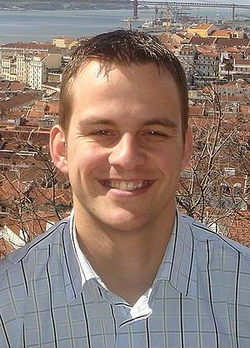







Thanks for your attention
Thanks for your attention
Thanks for your attention
Thanks for your attention
Thanks for your attention
Thanks for your attention
Thanks for your attention
Thanks for your attention
Thanks for your attention
Thanks for your attention

