Slide 1
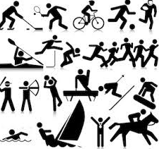
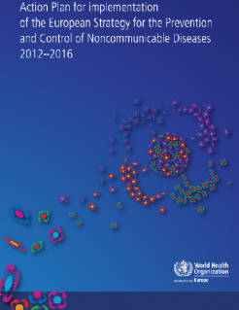
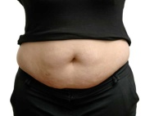
EULAR Study Group: Public Health in Rheumatic and Musculoskeletal Diseases Suzanne M.M. Verstappen on behalf of the Study Group
Who we are:
What we do:
Future publications:
This Study Group is linked to the Epidemiology and Health Services Research Standing Committee of EULAR.
Current initiative (April 2018 – December 2019): Points to consider for lifestyle behaviour to prevent the progression of Rheumatic and Musculoskeletal Diseases (RMDs).
To develop points to consider identifying key recommendations for healthy lifestyle strategies to prevent the progression of specific RMDs and associated impact for the patient and society (e.g. disability, economic loss).
Guidelines for patients:
“Recommendations in lay language to be distributed via PARE and national patient organisations”
Scientific Outputs:
“Abstracts to EULAR and scientific publications”
Aim of the study group:
The Study Group aims to promote research in Public Health for RMDs.
Health professional in RMD health:
“Report and information material about final recommendations , including a summary of scientific evidence and links to scientific evidence”
Written communication
Promotion via existing websites
Background:
Target population & Specific objectives:
Rheumatic and Musculoskeletal Diseases (RMDs) cause the greatest burden of disability in Europe and this burden is increasing due to:
Aging population
Changes in determinants musculoskeletal health such as obesity, nutrition, smoking, physical activity
Changes in working conditions
There is increasing recognition of the burden of RMDs by WHO Europe (e.g. Action Plan for the Prevention and Control of Non-communicable Diseases) and other national and international organisations.
Promotion of more specific aspects of health (e.g. Physical activity, nutrition/weight, smoking, working conditions), along with more effective disease management, may prevent progression of RMDs and associated health outcomes or patient reported outcomes.
Dealing with the consequences of RMDs is also of key importance at the Public Health level.
In populations with osteoarthritis (OA), rheumatoid arthritis (RA), ankylosing spondylitis (AS), psoriatic arthritis (PsA), systemic scleroderma (SSc), systemic lupus erythamosus (SLE) and gout to review the evidence on:
The association between diet and progression of RMDs, both benefits and harms (e.g. on disease activity, development of co-morbidities)?
The association between paid work and the progression of RMDs and work outcomes, both benefits and harms (e.g. physical and mental health, social role participation, worker productivity loss)?
The association between physical activity and progression of RMDs, both benefits and harms (e.g. radiographic progression, development co-morbidities)?
The association between smoking and progression of RMDs, both benefits and harms (e.g. on disease activity, development of co-morbidities)?
The association between weight and progression of RMDs, both benefits and harms (e.g. on disease activity, radiographic progression)?
The association between alcohol and progression of RMDs, both benefits and harms (e.g. on disease activity, radiographic progression)?
Information for policy makers:
“Report with recommendations on the influence of lifestyle factors to inform EULAR Public Affairs office, WHO and EU, including summary of of possible implications of promoting health behaviour or to develop future interventions”
Task Force:
Suzan Verstappen (UK) (Leader), Francis Guillemin (Methodologist) (France), James Gwinnutt (Fellow) (UK), Maud Wieczorek (Fellow) (France), Joep Welling and Savia de Souza (PARE representatives), Giulio Cavalli and Javier Rodriguez Carrio (EMEUNET representatives), Tanja Stamm (Austria), Polina Putrik (the Netherlands), Lucia Silva-Fernandez (Spain), Annelies Boonen (the Netherlands), Karen Walker-Bone (UK), Mirjana Zlatkovic-Svenda (Serbia), Andra Balanescu (Romania), Heike Bischoff-Ferrari (Switzerland), Annette de Thurah (Denmark), Rikke Moe (Norway), Gabriele Gäbler (Austria), Thomas Dorner (Austria).
Point of contact:
Dr Suzanne M.M. Verstappen, Centre for Musculoskeletal Research, The University of Manchester, Manchester, UK: suzanne.verstappen@manchester.ac.uk
1

