Slide 1
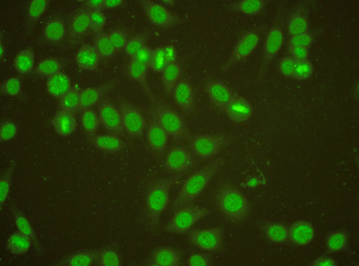
THE EUROPEAN CONSENSUS FINDING STUDY GROUP ON AUTOANTIBODIES (ECFSG) THE EULAR AUTOANTIBODY STUDY GROUP
Aim of the study group: to achieve a common consensus in autoantibody diagnostics: a laboratory result should be the same, independent of the country or laboratory where the result is obtained.
Yearly topics for serum investigations:
2004: anti-dsDNA antibodies
2005: anti-phospholipid antibodies
2006: myositis autoantibodies
2007: vaskulitis autoantibodies
2008: scleroderma-associated antibodies
2009-11: consistency testing
2012: cytoplasmatic ANA patterns
2013: anti-dsDNA antibodies
2018: myositis autoantibodies
2014-2018: tentative reference reagents
Anti-DFS70, the reference reagent investigated in 2018, yields an ANA pattern with similarities to patterns associated with rheumatic diseases. Anti-DFS70 has however no association to disease. The standard will soon be available
Background: Since 1988, the European Consensus Finding Study Group on autoantibodies in rheumatic diseases (ECFSG), has yearly distributed unknown sera to European laboratories (presently n=43) for evaluation in a clinical context.
Sera are chosen to reveal differences between different laboratories. Sera also selected to fit into a given topic. The results are discussed in conjunction to the European Workshop for Rheumatology Research (EWRR) every year.
Since 2014 a focus has been on evaluating samples that might constitute new reference materials for clinical laboratories. The first tested sample has now become the new WHO reference reagent for anti-dsDNA.
Tested tentative reference reagents:
2014: anti-dsDNA (now publicly available WHO standard, NIBSC 15/174)
2015: ACPA
2016: anti-PR3 (standard available from the EU Science Hub, ERM-DA483/IFCC)
2016: anti-MPO (standard available from the EU Science Hub, ERM-DA476/IFCC)
2016: IgG anti-β2GP1
2017: anti-GBM
2018: anti-DFS70
The ECFSG Steering committee:
Johan Rönnelid, Uppsala, Sweden (chairman; johan.ronnelid@igp.uu.se)
Charlotte Dahle, Linköping, Sweden
Dörte Hamann, Amsterdam, Netherlands
Eugen Feist, Berlin, Germany
Martin Blüthner, Karlsruhe, Germany

