Slide 1
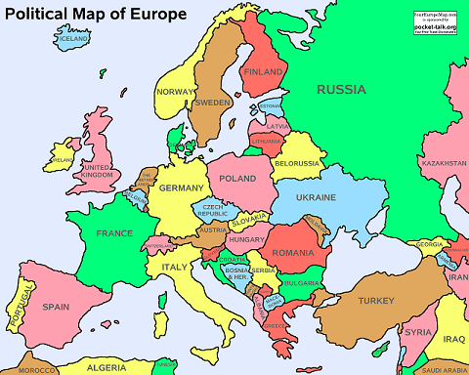
Foot & Ankle Study Group
The Foot and Ankle Study Group is to encourage wider communication within the EULAR family for HPs with an interest in foot and ankle care
The group is informal and provides an encouraging and open forum that enables HPs new to EULAR or the field to gain confidence in preparing and presenting research, audits, papers and presentations.
HEALTH PROFESSIONAL SESSION PROPOSAL
EULAR Annual Congress 2020 in Fractfurt
Bio-Psycho-Social Approach to People Living with Foot SSc
Present the current clinical understanding of foot SSc, related consequences and disabilities
2. Define the bio-psycho-social analytical framework of people with foot SSc according to the ICF classification; identify the professional figures involved and their outcome definition
3. Describe the latest advances on ulcer management and the role of peer-to-peer skills transfer in prevention and intervention
4. Demonstrate the critical role of caregivers, doctor-patient relations, and multidisciplinary network relations in the treatment of complex cases of patients with SSc
The study group is open for new members continually and we hope to expand the network and encourage wider representation from more EULAR member countries as far as possible. This year, we have increased the number of member with 3 PARE member from Portugal, Cyprus and UK
For further information please contact the convener Dr. Gabriel Gijon Nogueron (gagijon@uma.es) and co-convener Robert Field (rfield@nhs.net)
20/4/18

