Slide 1
2019 update of the Joint European League Against Rheumatism and European Renal Association–European Dialysis and Transplant Association (EULAR/ERA-EDTA) recommendations for the management of lupus nephritis

Slide 2
Target population/question
Target population included Internists, Rheumatologists and Nephrologists
Questions:
Prognostic significance of kidney biopsy findings
Risk stratification of patients of lupus nephritis
Use of hydroxychloroquine in lupus nephritis
Induction therapies in lupus nephritis (including glucocorticoids and calcineurin inhibitors)
Maintenance therapies in lupus nephritis
How should lupus nephritis be monitored?
What is the goal of treatment in lupus nephritis?
What is the optimal duration of immunosuppressive treatment in lupus nephritis?
What is the definition of refractory lupus nephritis?
How should refractory/flaring lupus nephritis be treated?
Management of lupus nephritis during pregnancy and lactation
Management of APS nephropathy
Management of end-stage renal disease in lupus nephritis
Renal transplantation in patients with lupus nephritis
Comorbidities in lupus nephritis (cardiovascular disease, infections)

Slide 3
Methods/methodological approach
Consensual approach
Main research questions (including specific topics of interest)
Systematic literature research (SLR)
Extrapolation of the SLR results to inform clinically relevant topics
Draft of initial statements based on available evidence and expert opinion
Consensual approach
FINAL Recommendations
van der Heijde D, et al. Ann Rheum Dis. 2015; 74: 8-13

Slide 4
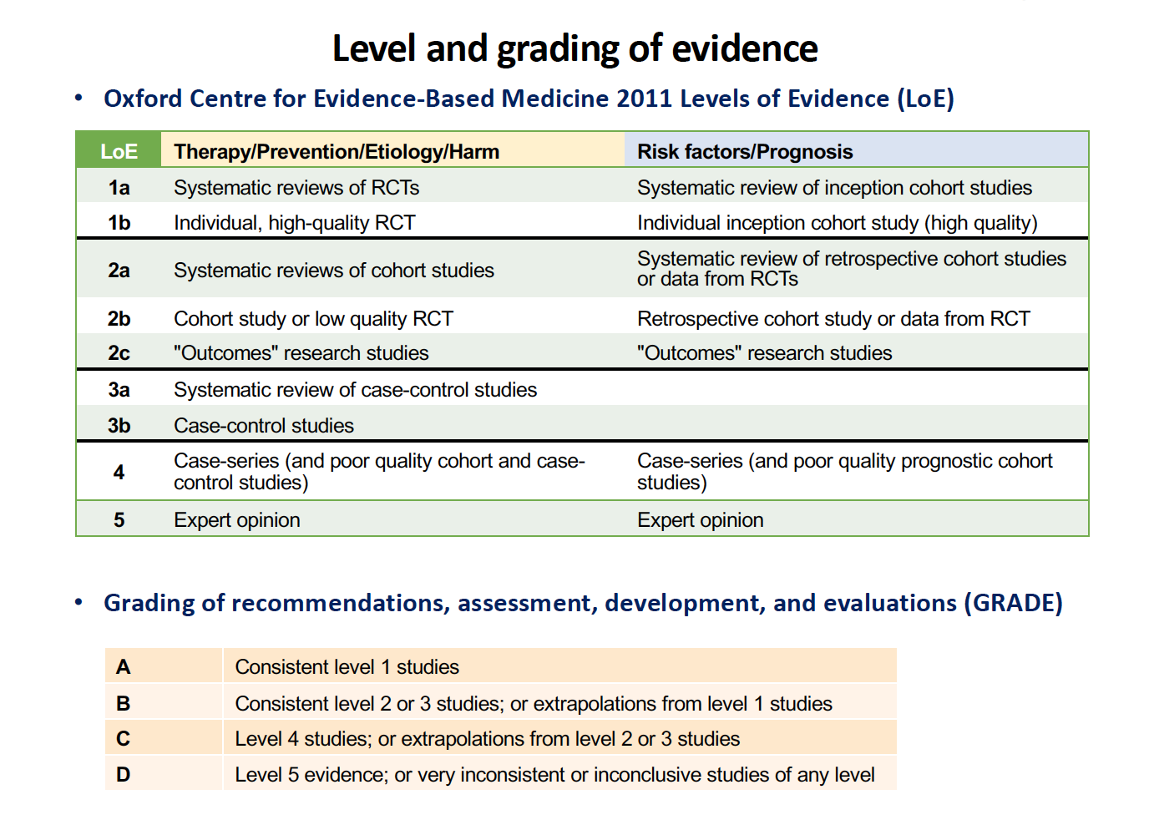
Methods/methodological approach

Slide 5
Overarching principles
• Kidney involvement in SLE is best managed by interdisciplinary care with shared patient-physician decisions.
• Vigilance for symptoms and signs suggestive of kidney involvement, histological assessment by nephropathologists and input from specialized centres ensure optimal outcomes.
• Goals of treatment include patient survival, long-term preservation of kidney function, prevention of disease flares, prevention of organ damage, management of comorbidities and improvement in disease-related quality of life.
• Management includes an initial period of intense immunosuppressive therapy to control disease activity, followed by a longer period of less intensive therapy to consolidate response and prevent relapses.

Slide 6
Individual Recommendations and Level of Evidence
Recommendations
Investigation of the patient with suspected lupus nephritis 1.1 Kidney biopsy when there is evidence of kidney involvement, especially proteinuria ≥0.5 g/24hr (2b/B) and/or an unexplained decrease in glomerular filtration rate (2b/C).
1.2 Kidney biopsy remains indispensable and its diagnostic and prognostic value cannot be substituted by other clinical or laboratory variables (2b/B).
2. Pathological assessment of kidney biopsy 2.1 Use of the ISN/RPS 2003 classification system is recommended (2a/B), with assessment of activity and chronicity indices (1b/A), thrombotic and vascular lesions associated with antiphospholipid antibodies (2b/C).
3. Indications for immunosuppressive treatment 3.1 Immunosuppressive agents, administered in combination with glucocorticoids, are recommended in class IIIA or IIIA/C (±V) and IVA or IVA/C (±V) nephritis (1a/A).
3.2 In pure class V nephritis, glucocorticoids and immunosuppression are recommended in cases of nephrotic-range proteinuria (2b/B) or UPCR >1000 mg/g despite the optimal use of renin-angiotensin-aldosterone system blockers (5/D).

Slide 7
Individual Recommendations and Level of Evidence
Recommendations
4. Treatment of adult lupus nephritis Goals of treatment 4.1 Treatment aims for optimization of kidney function, with a reduction in proteinuria of at least 25% by 3 months (2b/D), 50% by 6 months (2a/B) and a UPCR target below 500–700 mg/g by 12 months (2a/B).
4.2 Patients with nephrotic-range proteinuria may require an additional 6–12 months to reach complete clinical response (2a/C).
Initial treatment 4.3 For class III or IV (±V) nephritis, mycophenolate mofetil (1a/A) or low-dose intravenous (IV) cyclophosphamide (CY) (1a/A), in combination with glucocorticoids, are recommended.
4.4 Combination of mycophenolate mofetil with a calcineurin inhibitor (especially tacrolimus) is an alternative, particularly in patients with nephrotic-range proteinuria (1a/B).
4.5 Patients at high risk for kidney failure can be treated as in 4.3-4.4 (2b/B), but high-dose IV CY can also be considered (1a/B).

Slide 8
Individual Recommendations and Level of Evidence
Recommendations
4. Treatment of adult lupus nephritis Initial treatment 4.6 The use of IV pulses methylprednisolone is recommended, followed by oral prednisone (0.3–0.5 mg/kg/day) for up to 4 weeks, tapered to ≤7.5mg/day by 3 to 6 months (2b/B).
4.7 In pure class V nephritis, MMF (2a/B) in combination with pulse IV methylprednisolone followed by oral prednisone (20 mg/day, tapered to ≤5 mg/day by 3 months) (2b/C) is recommended.
4.8 Alternative options for class V nephritis include IV CY (2b/B), or calcineurin inhibitors (especially tacrolimus) in monotherapy (2b/B) or in combination with MMF/MPA (1b/B).
4.9 Hydroxychloroquine (HCQ) should be co-administered (2a/B) at a dose not to exceed 5 mg/kg/day (3b/C) and adjusted for the glomerular filtration rate.

Slide 9
Individual Recommendations and Level of Evidence
Recommendations
4. Treatment of adult lupus nephritis
Subsequent treatment 4.10 If improvement is achieved, subsequent immunosuppression is recommended with either MMF/MPA (1a/A) or azathioprine (1a/A), in combination with low-dose prednisone when needed.
4.11 Gradual withdrawal of treatment (glucocorticoids first) can be attempted after at least 3 to 5 years therapy in complete clinical response (2b/C). HCQ should be continued long-term.
4.12 Continuation, switching to or addition of calcineurin inhibitors can be considered in pure class V nephritis (2b/B) at the lowest effective dose.
Refractory disease
4.13 In case of failure to achieve the treatment goals, thorough evaluation of the possible causes is recommended, including assessment of adherence to treatment and therapeutic drug monitoring (5/D).
4.14 For active non-responding/refractory disease, treatment may be switched to one of the alternative initial therapies mentioned above (2b/B–C) or rituximab be given (2b/C).

Slide 10
Individual Recommendations and Level of Evidence
Recommendations
5. Adjunct treatment in patients with lupus nephritis 5.1 ACE-inhibitors/ARBs are recommended for patients with UPCR >500 mg/g or hypertension (5/D).
5.2 Statins are recommended on the basis of lipid levels and estimated 10-year cardiovascular risk (5/D).
5.3 Bone protection (calcium/vitamin D supplementation and/or anti-resorptive agents) and immunizations with non-live vaccines may reduce comorbidities and are recommended (5/D).
5.4 If antiphospholipid antibodies are positive, acetyl-salicylic acid (80-100 mg/day) may be used after balancing benefits and bleeding risk (2a/C).
5.5 Anticoagulant treatment should be considered in cases of nephrotic syndrome with serum albumin <20 g/L, presence of antiphospholipid antibodies, or other thrombophilia (5/D).
5.6 Belimumab may be considered as add-on treatment, to facilitate glucocorticoid sparing, control extra-renal lupus activity and decrease the risk for extra-renal flares (2a/C).

Slide 11
Individual Recommendations and Level of Evidence
Recommendations
6. Monitoring and prognosis of lupus nephritis 6.1 Visits should be scheduled every 2–4 weeks during the first 2–4 months after diagnosis or flare, and subsequently, according to response to treatment (5/D).
6.2 Body weight, blood pressure, estimated GFR, serum albumin, proteinuria, urine red cell count or sediment, and CBC count should be evaluated (2b/B). Serum C3/C4 and anti-dsDNA antibody levels are monitored periodically (2b/C).
6.3 Repeat kidney biopsy should be considered in selected cases (worsening of kidney variables, non-responsiveness to treatment, or at relapse), to demonstrate possible histologic class transition or change in chronicity and activity indices; to provide prognostic information; and detect other pathologies (2b/B).

Slide 12
Individual Recommendations and Level of Evidence
Recommendations
7. Management of end-stage kidney disease in lupus nephritis 7.1 All methods of kidney replacement treatment can be used in SLE patients (2b/B).
7.2 Immunosuppression in ESKD on dialysis is guided by extra-renal manifestations (2b/C).
7.3 Transplantation may be preferred over other kidney replacement options (2b/C); outcomes are better with living donor (2b/C) and pre-emptive transplantation (2b/C).
7.4 Antiphospholipid antibodies should be measured during transplant preparation, because they are associated with an increased risk of vascular events in the transplanted kidney (2b/C).
8. Antiphospholipid syndrome and lupus nephritis 8.1 In patients with antiphospholipid syndrome-associated nephropathy, antiplatelet/anticoagulant treatment can be considered, in addition to HCQ (2b/C).

Slide 13
Individual Recommendations and Level of Evidence
Recommendations
9. Lupus nephritis and pregnancy 9.1 Pregnancy may be planned in stable patients with inactive lupus nephritis (1b/A).
9.2 Compatible medications such as HCQ (1b/B), prednisone, AZA, calcineurin inhibitors (all 3b/C) should be continued at safe dosages throughout pregnancy and lactation.
9.3 MMF/MPA should be withdrawn at least 3–6 months before conception is planned (5/D).
9.4 During pregnancy, acetylsalicylic acid is recommended to reduce the risk of pre-eclampsia (2b/C).
9.5 Patients should be assessed at least every 4 weeks, preferably by a multidisciplinary team (5/D).
9.6 Flares of lupus nephritis during pregnancy can be treated with acceptable medications stated above and pulses of IV-MP, depending on flare severity (3b/C).

Slide 14
Individual Recommendations and Level of Evidence
Recommendations
10. Management of paediatric lupus nephritis 10.1 Lupus nephritis in children is more common at presentation and more severe with increased damage accrual; the diagnosis, management and monitoring are similar to that of adults (3b/C).
10.2 A coordinated transition program to adult specialists is essential to ensure adherence to therapy and optimization of long-term outcomes (5/D).

Slide 15
Summary of Recommendations in bullet point format
Perform kidney biopsy if kidney involvement is suspected
Use of the ISN/RPS 2003 classification system to determine active/chronic lesions, possible evidence of antiphospholipid-antibody associated nephropathy and risk stratification
Indications for immunosuppressive therapy: active class III-IV, or class V with proteinuria >3 g/24-hr or >1 g/24-hr despite renin-angiotensin-aldosterone system blockade
Target: reduction in proteinuria of ≥25% by 3 months, 50% by 6 months and below 500–700 mg/g by 12 months; patients with nephrotic-range proteinuria may need more time to reach the targets
Induction treatment: low-dose IV CYC or MMF; alternatively, combination of MMF with tacrolimus, especially if nephrotic-range proteinuria; high-dose IV CYC if adverse prognostic factors
Maintenance treatment: MMF or AZA
In refractory cases, switch to alternative initial treatment, or rituximab; consider repeat biopsy
Control comorbidities
Kidney transplantation may be preferable over other renal replacement modalities.
Acceptable medications during pregnancy include hydroxychloroquine, low dose prednisone, azathioprine and calcineurin inhibitors (especially tacrolimus)
Diagnosis, management and monitoring of paediatric lupus nephritis is similar to that of adults; a coordinated transition program is essential

Slide 16
Summary of Recommendations in lay format
In patients with SLE, persistent urine abnormalities – especially proteinuria – are an indication for kidney biopsy, to establish the diagnosis, guide therapy and evaluate prognosis of nephritis.
Immunosuppressive therapy should be prescribed when lupus kidney disease has a high inflammatory burden, particularly active proliferative (class III-IV) lesions.
Initial therapy consists of low-dose cyclophosphamide or mycophenolate, followed by a subsequent, longer phase with mycophenolate or azathioprine.
The goals of treatment include long-term preservation of kidney function, prevention of nephritis relapses (“flares”) and accumulation of organ damage, management of comorbidities and improvement in patient quality of life.
Patients require close monitoring to ensure adequate response to therapy; non-responding cases should be carefully evaluated and treatment be changed accordingly
Comorbidities are important for the long-term prognosis and require vigilance and proper prevention and treatment
During pregnancy, patients with lupus nephritis should be closely monitored and treated with acceptable medications
Lupus nephritis in children should be managed similarly with adults

Slide 17
Acknowledgements
Support for this work was provided through a grant from the EULAR Standing Committee on Clinical Affairs (ESCCA).

