Slide 1
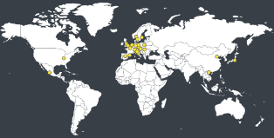
EULAR study group on myositis – MyoNet
Euromyositis register
Aims of MyoNet study group
To improve clinical care
To disseminate new knowledge on myositis
To strengthen research on myositis
To disseminate information on current studies
To facilitate collaborations between research groups in different countries
To offer training sessions on how to enroll patients in the web-based myositis registry, Euromyositis
To identify biomarkers for prognosis
What we do
The Euromyositis register is the core of our activities. It is constantly undergoing development to facilitate its use in clinical care and in research.
We have a new module for the New EULAR/ACR classification criteria for myositis
A tool to extract data is available
Publication: Lilleker JB et al. The EuroMyositis registry: an international collaborative tool to facilitate myositis research. Ann Rheum Dis. 2018 Jan;77(1):30-39.
Aims of MyoNet study group
Aims of MyoNet study group
May 2019: more than 5 000 patients from 23 centers
Welcome to join the Euromyositis registry, www.euromyositis.eu
Hector.Chinoy@manchester.ac.uk;
If you are interested to join MyoNet
contact Ingrid Lundberg
ingrid.lundberg@ki.se

