Slide 1
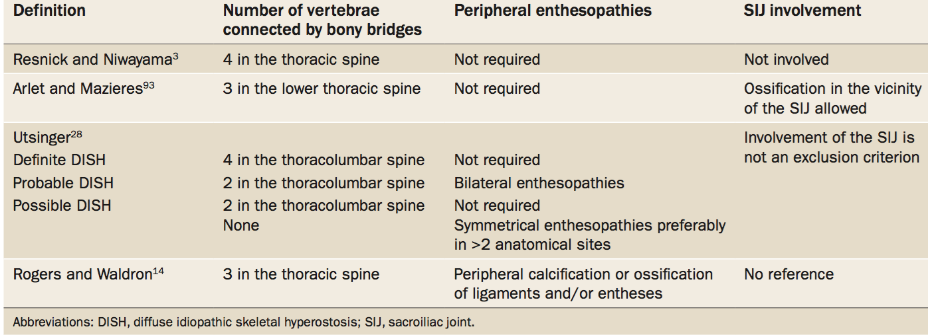
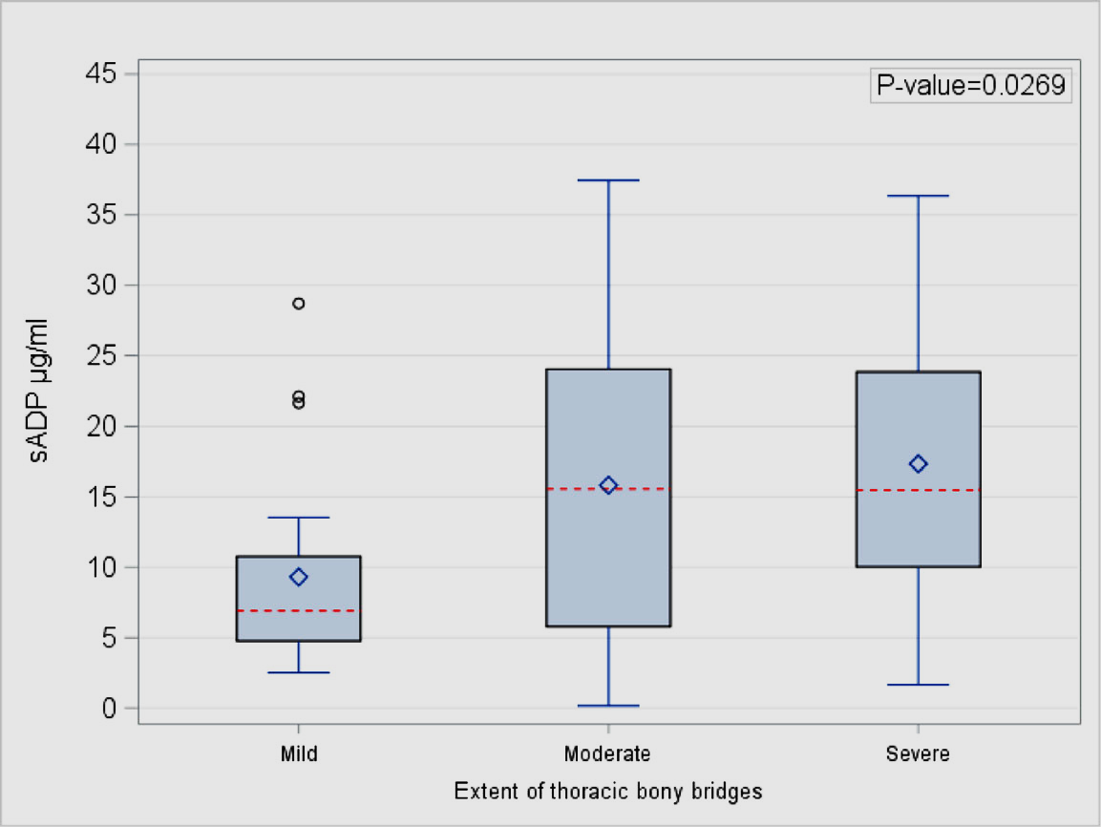
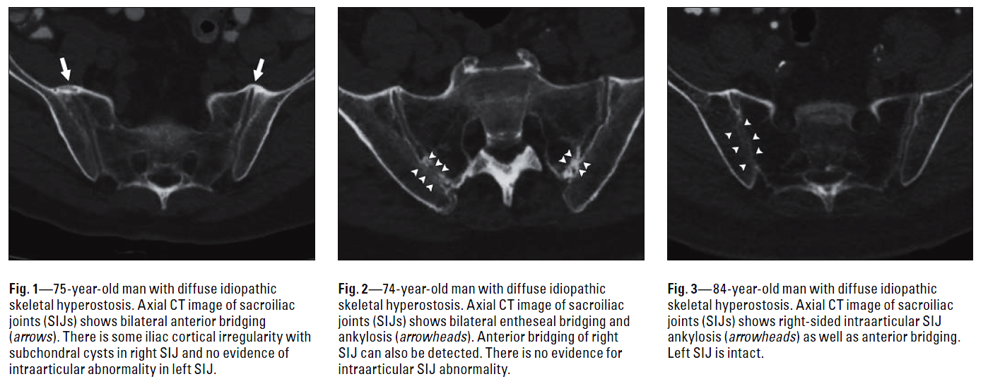
EULAR Diffuse Idiopathic Skeletal Hyperostosis (DISH)
Study Group
Samples of studies published by members of the group
AIM OF THE STUDY GROUP
BACKGROUND OF DISH
Serum adiponectin levels in patients with diffuse
idiopathic skeletal hyperostosis (DISH).
The aim of the Study Group is to investigate the clinical presentation, the necessary diagnostic procedures for ensuring the diagnosis of diffuse idiopathic skeletal hyperostosis (DISH). At present, the diagnosis is made late in the course of the disease when the hyperostotic changes are irreversible. The Study Group is aiming to establish ways that will enable early diagnosis of the condition before damage occurs. It is therefore of interest to identify patients at risk for the development of this condition either by the identification of co-morbidities that might promote the emergence of DISH, genetic susceptibility for DISH, and pathogenetic pathways that might become target for future therapeutic interventions.
MAIN DIAGNOSTIC FEATURES
CURRENT PLANS – RESEARCH AGENDA
Organize and present a systematic literature review of the currently existing criteria for diagnosing DISH in daily practice
Assess the value of clinical symptoms and objective findings (including imaging and laboratory markers) and producing a diagnostic algorithm for patients who are clinically suspicious for DISH
Organize long-term projects with patients diagnosed with DISH in order to document the natural process of the disease, including current treatment practices
Identify factors that may be able to predict the development of the typical structural bony changes leading to functional disability and pain in patients with metabolic syndrome
Investigate the pathogenetic pathways that lead to new bone formation
Investigate if the disease is conditioned by a genetic predisposition.
To generate an atlas that will depict the characteristic imaging of DISH
Mader, Verlaan & Buskila, Nat Rev Rheumatol 2013
sADP in micrograms per milliliter by extent of thoracic bony bridges. Boxplot legend: diamond =mean;
dashed line = median. Mader R et al Clinical Rheumatology (2018) 37:2839–2845
Ankylosing spondylitis and diffuse idiopathic skeletal hyperostosis
can be present simultaneously. Criteria for diffuse idiopathic skeletal hyperostosis should be reconsidered
CT Abnormalities in the Sacroiliac Joints of Patients With Diffuse Idiopathic Skeletal Hyperostosis. Leibushor N et al, AJR:208, April 2017
Kuperus JK et al. Rheumatology (oxford) 1;57(12):2120-2128ת 2018
MEMBERS
Coordinators and current members : Xenofon Baraliakos (Germany, current coordinator), Reuven Mader (Israel, current coordinator), Jorrit-Jan Verlaan (The Netherlands), Iris Eshed (Israel), Bruges-Armas Jacomé (Portugal), Piercarlo Sarzi Puttini (Italy), Fabiola Atzeni (Italy), Dan Buskila (Israel), Irina Novofastovski (Israel), Kurt de Vlaam (Belgium), Walter A Sifuentes Giraldo (Spain), Andreas Schröder, (Germany, patient´s representative). Additional patient´s representatives are currently in discussion with the group. The Study Group is open to anyone interested in the diagnosis, treatment and prognosis of patients with DISH.

