Slide 1
EULAR recommendations for the management of psoriatic arthritis with pharmacological therapies: 2019 update
Laure Gossec, Xenofon Baraliakos, Andreas Kerschbaumer, Maarten de Wit, Iain B. McInnes, Maxime Dougados, Jette Primdahl, Dennis McGonagle, Daniel Aletaha, Andra Balanescu, Peter Balint, Heidi Bertheussen, Wolf-Henning Boehncke, Gerd R. Burmester, Juan D. Cañete, Nemanja Damjanov, Tue Wenzel Kragstrup, Tore K. Kvien, Robert Landewé, Rik Lories, Helena Marzo-Ortega, Denis Poddubnyy, Santiago Rodrigues, Georg Schett, Douglas J Veale, Filip van den Bosch, Désirée van der Heijde, Josef S. Smolen

Slide 2
Target population/question
EULAR recommendations for the management of psoriatic arthritis: 2019 update
Target population: patients with psoriatic arthritis (PsA)
Objective: to update the 2015 EULAR management recommendations for PsA
  Dealing with general treatment principles
  And pharmacological non topical treatment
Musculoskeletal manifestations: rheumatologists‘ point of view

Slide 3
Methods
EULAR recommendations for the management of psoriatic arthritis: 2019 update
According to the EULAR Standardized Operating Procedures
Meeting of steering group (October 2018): decisions on scope of the literature review
Systematic literature review of drugs efficacy and safety
General literature review of treatment strategies, prognosis and comorbidities
Taskforce full meeting (May 2019):
  Presentation of literature review
  Discussions based on the 2015 recommendations
  Elaboration of updated recommendations
  Determination of level of strength and grade of recommendations
Votes by email on level of agreement of Taskforce members
(0-10 where 10 is full agreement)
Oxford levels of evidence, 2009

Slide 4
Methods
EULAR recommendations for the management of psoriatic arthritis: 2019 update
According to the EULAR Standardized Operating Procedures¹ for recommendations
Nov 2018 – April 2019
14 May 2019
May 2019
End of 2019
October 2018
Meeting of Steering Group
Systematic
Literature
Review
Taskforce
Meeting
Votes of agreement
Dissemination
Determination of levels of evidence and grade of recommendations ²
van der Heijde D et al. Ann Rheum Dis 2016,75:3-15
Oxford Centre for Evidence-based Medicine. Levels of Evidence 2009
Notes:
Meeting of steering group: decisions on scope of the literature review and taskforce composition
Systematic literature review of drugs
General literature review of treatment strategies, prognosis
Taskforce full meeting
Presentation of literature review
Discussions based on the 2016 recommendations
Elaboration of updated recommendations
Votes by email on level of agreement of Taskforce members (0-10 where 10 is full agreement)
Determination of level of evidence

Slide 5
EULAR recommendations for the management of psoriatic arthritis: 2019 update
Overarching principles A-C
A. Psoriatic arthritis is a heterogeneous and potentially severe disease, which may require multidisciplinary treatment.
B. Treatment of psoriatic arthritis patients should aim at the best care and must be based on a shared decision between the patient and the rheumatologist, considering efficacy, safety and costs.
C. Rheumatologists are the specialists who should primarily care for the musculoskeletal manifestations of patients with psoriatic arthritis; in the presence of clinically significant skin involvement a rheumatologist and a dermatologist should collaborate in diagnosis and management.

Slide 6
EULAR recommendations for the management of psoriatic arthritis: 2019 update
Overarching principles D-F
D. The primary goal of treating patients with psoriatic arthritis is to maximise health-related quality of life, through control of symptoms, prevention of structural damage, normalisation of function and social participation; abrogation of inflammation is an important component to achieve these goals.
E. In managing patients with psoriatic arthritis, consideration should be given to each musculoskeletal manifestation and treatment decisions made accordingly.
F. When managing patients with psoriatic arthritis, non-musculoskeletal manifestations (skin, eye and gastrointestinal tract) should be taken into account; comorbidities such as metabolic syndrome, cardiovascular disease or depression should also be considered.

Slide 7
EULAR recommendations for the management of psoriatic arthritis: 2019 update
Recommendation 1
1. Treatment should be aimed at reaching the target of remission or, alternatively, low disease activity, by regular disease activity assessment and appropriate adjustment of therapy.
Notes:
Slight reformulation taking out mda from the sentence as is a score not a target per se

Slide 8
EULAR recommendations for the management of psoriatic arthritis: 2019 update
Recommendations 2, 3
2. Non-steroidal anti-inflammatory drugs may be used to relieve musculoskeletal signs and symptoms.
3. Local injections of glucocorticoids should be considered as adjunctive therapy in psoriatic arthritis; systemic glucocorticoids may be used with caution at the lowest effective dose.
Notes:
Slight reformulation taking out mda from the sentence as is a score not a target per se

Slide 9
EULAR recommendations for the management of psoriatic arthritis: 2019 update
Recommendations on first DMARD
4. In patients with polyarthritis, a csDMARD should be initiated rapidly, with methotrexate preferred in those with relevant skin involvement.
5. In patients with mono- or oligo-arthritis, particularly with poor prognostic factors such as structural damage, high ESR/CRP, dactylitis or nail involvement, a csDMARD should be considered.
Updated list of poor prognostic factors: (Polyarthritis), Structural damage, Elevated acute phase reactants, Dactylitis, Nail involvement
csDMARDs= conventional synthetic disease-modifying anti-rheumatic drugs, such as methotrexate, sulfasalazine, or leflunomide
1, Kerschbaumer A et al in preparation

Slide 10
EULAR recommendations for the management of psoriatic arthritis: 2019 update
Recommendation 6
6. In patients with peripheral arthritis and an inadequate response to at least one csDMARD, therapy with a bDMARD should be commenced;
when there is relevant skin involvement, an IL17- or IL-12/23-inhibitor may be preferred.
bDMARDs= biological disease-modifying anti-rheumatic drugs, this term includes here TNF inhibitors, drugs targeting the IL17 and IL12-23 pathways

Slide 11
EULAR recommendations for the management of psoriatic arthritis: 2019 update
Recommendations 7, 8
7. In patients with peripheral arthritis and an inadequate response to at least one csDMARD and at least one bDMARD, or when a bDMARD is not appropriate, a JAK inhibitor may be considered.
8. In patients with mild disease and an inadequate response to at least one csDMARD, in whom neither a bDMARD nor a JAK inhibitor is appropriate, a PDE4 inhibitor may be considered.

Slide 12
EULAR recommendations for the management of psoriatic arthritis: 2019 update
Recommendations 9,10
9. In patients with unequivocal enthesitis and insufficient response to NSAIDs or local glucocorticoid injections, therapy with a bDMARD should be considered.
10. In patients with predominantly axial disease which is active and has insufficient response to NSAIDs, therapy with a bDMARD should be considered, which according to current practice is a TNF inhibitor; when there is relevant skin involvement, an IL17 inhibitor may be preferred.

Slide 13
EULAR recommendations for the management of psoriatic arthritis: 2019 update
Recommendations 11, 12
11. In patients who fail to respond adequately to, or are intolerant of a bDMARD, switching to another bDMARD or tsDMARD should be considered, including one switch within a class.
12. In patients in sustained remission, cautious tapering of DMARDs may be considered.

Slide 14
Summary Table Oxford Level of Evidence
EULAR recommendations for the management of psoriatic arthritis: 2019 update
Recommendation number | Level of evidence | Grade of recommendation | Level of agreement (mean± standard deviation, 0-10)
1. | 1b | A | 9.4 (1.0)
2. | 1b | A | 9.6 (0.8)
3. | ª: 3b ^{b}: 4 | C | 9.5 (1.1)
4. | ª: 1b ^{b}: 5 | B | 9.5 (0.8)
5. | 4 | C | 9.3 (1.0)
6. | 1b | B | 9.4 (1.1)
7. | 1b | B | 9.2 (1.3)
8. | ª: 5 ^{b}: 1b | B | 8.5 (1.9)
9. | 1b | B | 9.3 (0.9)
10. | 1b | B | 9.7 (0.6)
11. | ª: 1b ^{b}: 4 | C | 9.5 (1.2)
12. | 4 | C | 9.5 (0.9)

Slide 15
Summary of Recommendations
EULAR recommendations for the management of psoriatic arthritis: 2019 update
Number | Recommendation
1. | Treatment should be aimed at reaching the target of remission or, alternatively, low disease activity, by regular disease activity assessment and appropriate adjustment of therapy.
2. | Non-steroidal anti-inflammatory drugs may be used to relieve musculoskeletal signs and symptoms.
3. | Local injections of glucocorticoids should be considered as adjunctive therapy in psoriatic arthritisª; systemic glucocorticoids may be used with caution at the lowest effective dose^{b}.
4. | In patients with polyarthritis, a csDMARD should be initiatedª rapidly^{b}, with methotrexate preferred in those with relevant skin involvementª.
5. | In patients with mono- or oligo-arthritis, particularly with poor prognostic factors such as structural damage, high ESR/CRP, dactylitis or nail involvement, a csDMARD should be considered.
6. | In patients with peripheral arthritis and an inadequate response to at least one csDMARD, therapy with a bDMARD should be commenced; when there is relevant skin involvement, an IL17- or IL-12/23-inhibitor may be preferred.
7. | In patients with peripheral arthritis and an inadequate response to at least one csDMARD and at least one bDMARD, or when a bDMARD is not appropriate, a JAK inhibitor may be considered.
8. | In patients with mild diseaseª and an inadequate response to at least one csDMARD^{b}, in whom neither a bDMARD nor a JAK inhibitor is appropriateª, a PDE4 inhibitor may be considered.
9. | In patients with unequivocal enthesitis and insufficient response to NSAIDs or local glucocorticoid injections, therapy with a bDMARD should be considered.
10. | In patients with predominantly axial disease which is active and has insufficient response to NSAIDs, therapy with a bDMARD should be considered, which according to current practice is a TNF inhibitor; when there is relevant skin involvement, IL-17 inhibitor may be preferred.
11. | In patients who fail to respond adequately to, or are intolerant of a bDMARD, switching to another bDMARD or tsDMARD should be consideredª, including one switch within a class^{b}.
12. | In patients in sustained remission, cautious tapering of DMARDs may be considered.

Slide 16
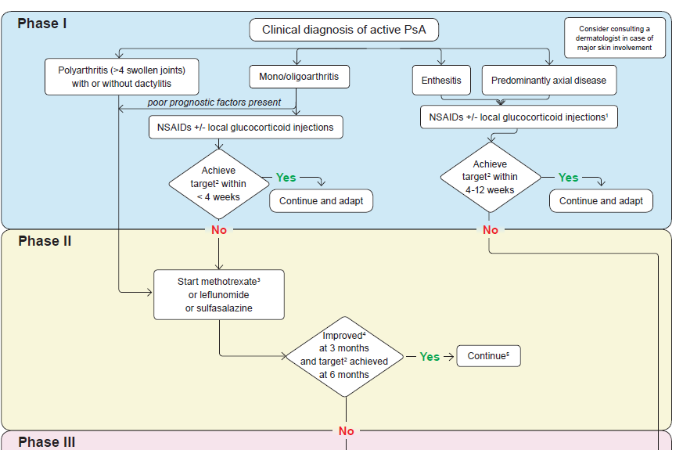

Slide 17
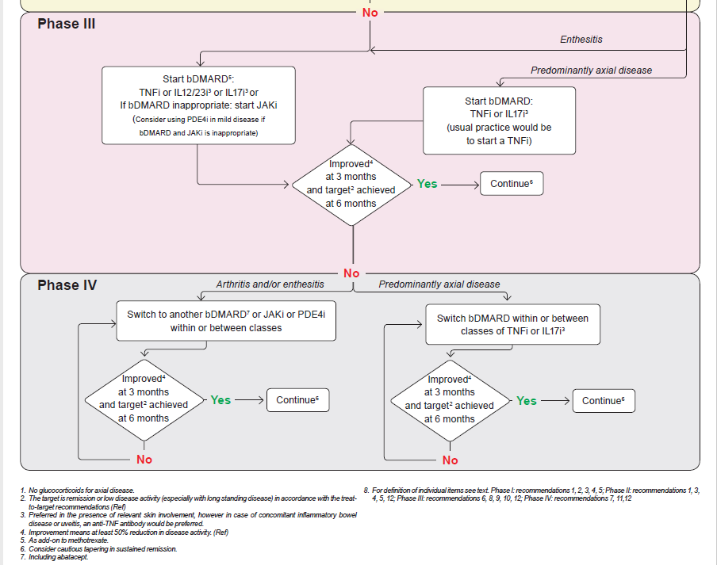

Slide 18
Summary of Recommendations in lay format
Recommendation | *
Your treatment goal should be remission or low disease activity; this is achieved with check-ups and adjusting treatment if needed | ****
Non-steroidal anti-inflammatory drugs may be used to relieve pain in your joints and entheses or spine | ****
Glucocorticoid injections should be considered; low doses of glucocorticoid pills can sometimes be used | **
People with many swollen joints should be quickly treated with a csDMARD – preferably methotrexate if their skin is also affected | ***
People with few swollen joints will also benefit from csDMARDs, especially if there is joint damage on X-rays, inflammation on blood tests, or disease affecting the nails or leading to swollen fingers | **
A bDMARD should be prescribed for people with swollen joints who have not responded to at least one csDMARD; if you have psoriasis as well an IL-17 or IL-12/23-inhibitor may be preferred
A JAKi may be considered if you have swollen joints and have not responded to at least one csDMARD and at least one bDMARD, or for people who cannot take bDMARDs | ***
1 star (*) means it is a weak recommendation with limited scientific evidence; 2 stars (**) means it is a weak recommendation with some scientific evidence; 3 stars (***) means it is a strong recommendation with quite a lot of scientific evidence; 4 stars (****) means it is a strong recommendation supported with a lot of scientific evidence.
Recommendations with just 1 or 2 stars are based mainly on expert opinion and not backed up by appropriate clinical studies, but may be as important as those with 3 and 4 stars.

Slide 19
Summary of Recommendations in lay format
Recommendation | *
If you cannot take a bDMARD or JAKi, a PDE4i may be considered for mild disease that has not responded to least one csDMARD | ***
A bDMARD should be considered for people with enthesitis who have not got better with NSAIDs or steroid injections | ***
A bDMARD should be considered for people whose disease is mostly in their back and who do not get relief from NSAIDs. A TNFi is the usual choice, but IL-17 inhibitors can be used if you have psoriasis as well | ***
People who do not respond to or get side effects from a bDMARD can be switched to a different bDMARD or a tsDMARD; this includes one switch within the same class of medicine | **
It should be discussed if we can withdraw DMARDs with caution, in people who are in sustained remission | **
1 star (*) means it is a weak recommendation with limited scientific evidence; 2 stars (**) means it is a weak recommendation with some scientific evidence; 3 stars (***) means it is a strong recommendation with quite a lot of scientific evidence; 4 stars (****) means it is a strong recommendation supported with a lot of scientific evidence.
Recommendations with just 1 or 2 stars are based mainly on expert opinion and not backed up by appropriate clinical studies, but may be as important as those with 3 and 4 stars.

