Slide 1
EULAR recommendations for the use of imaging in the clinical management of osteoarthritis

Slide 2
EULAR recommendations for the use of imaging in the clinical management of osteoarthritis
Methods: According to the EULAR Standardized Operating Procedures*
Consensual approach
Define questions for SLR
???????
Systematic literature research
Consensual approach
FINAL Recommendations
* van der Heijde et al Ann Rheum Dis 2016,75:3-15

Slide 3
Target population/research question
The aim of the task force was to develop recommendations on the use of imaging of the joints in patients with osteoarthritis (OA) based on evidence from the literature and expert opinion, taking into account:
Clinical and non surgical setting
Peripheral joints (knee, hip, hand, feet)
Imaging modalities: conventional radiography (CR)
ultrasonography (US)
magnetic resonance imaging (MRI)
computer tomography (CT)
radioisotope scan

Slide 4
Slide 2: Methods/methodical approach

Slide 5
Overarching principles
These recommendations pertain to symptomatic osteoarthritis.
Imaging abnormalities of osteoarthritis are commonly seen especially with increasing age.
Joint symptoms are also common and increase with age. Symptoms are not always causally related to imaging abnormalities.
Full history and examination is always required before considering the need for investigations, including imaging.
Modern imaging modalities provide the capability to detect a wide range of soft tissue, bony and cartilage pathology in osteoarthritis. However, the increased information provided has not yet had a major impact on clinical practice.

Slide 6
Recommendations
Imaging is not required to make the diagnosis in patients with typical* presentation of OA. *typical features include: usage-related pain, short duration morning stiffness, age>40, symptoms affecting one or a few joints.
In atypical presentations imaging is recommended to help confirm the diagnosis of OA and/or make alternative or additional diagnoses.
Routine imaging in OA follow-up is not recommended. However, imaging is recommended if there is unexpected rapid progression of symptoms or change in clinical characteristics to determine if this relates to OA severity or an additional diagnosis.

Slide 7
Recommendations
If imaging is needed, conventional (plain) radiography should be used before other modalities. To make additional diagnoses, soft tissues are best imaged by US or MRI and bone by CT or MRI.
Consideration of radiographic views is important for optimizing detection of OA features, in particular for the knee weightbearing and patellofemoral views are recommended.

Slide 8
Recommendations
According to current evidence, imaging features do not predict non-surgical treatment response and imaging cannot be recommended for this purpose.
The accuracy of intra-articular injection depends on the joint and on the skills of the practitioner and imaging may improve accuracy. Imaging is particularly recommended for joints that are difficult to access due to factors including site (e.g. hip), degree of deformity and obesity.

Slide 9
Summary Table Oxford Level of Evidence
Recommendation | Level of Evidence | Level of agreement Mean 95% CI
1 | III-IV | 8.7 (7.9 to 9.4)
2 | IV | 9.6 (9.1 to 10)
3 | III-IV | 8.8 (7.9 to 9.7)
4 | III-IV | 8.7 (7.9 to 9.6)
5 | III | 9.4 (8.7 to 9.9)
6 | II-III | 8.7 (7.5 to 9.7)
7 | III-IV | 9.4 (8.9 to 9.9)

Slide 10
Summary of Recommendations
Imaging is not required to diagnose OA in typical presentation, but its use is recommended in case of atypical presentation to allow differential diagnosis.
The routine use of imaging for OA follow-up is not recommended, unless ad unexpected rapid progression or a change in symptoms occur.
When imaging is needed, conventional radiography should be performed first and attention should be paid to the choice of radiographic views.
Imaging is not recommended for diagnostic purposes.
The use of imaging to guide intra-articular injections is recommended in particular conditions, such as joint deformity or obesity.

Slide 11
Summary of Recommendations in lay format
Imaging is not required to diagnose OA in typical presentation, but its use is recommended in case of atypical presentation to allow differential diagnosis. The routine use of imaging for OA follow-up is not recommended, unless ad unexpected rapid progression or a change in symptoms occur. When imaging is needed, conventional radiography should be performed first and attention should be paid in the choice of radiographic views. Imaging is not recommended for diagnostic purposes. The use of imaging to guide intra-articular injections is recommended in particular conditions, such as joint deformity or obesity.

Slide 12
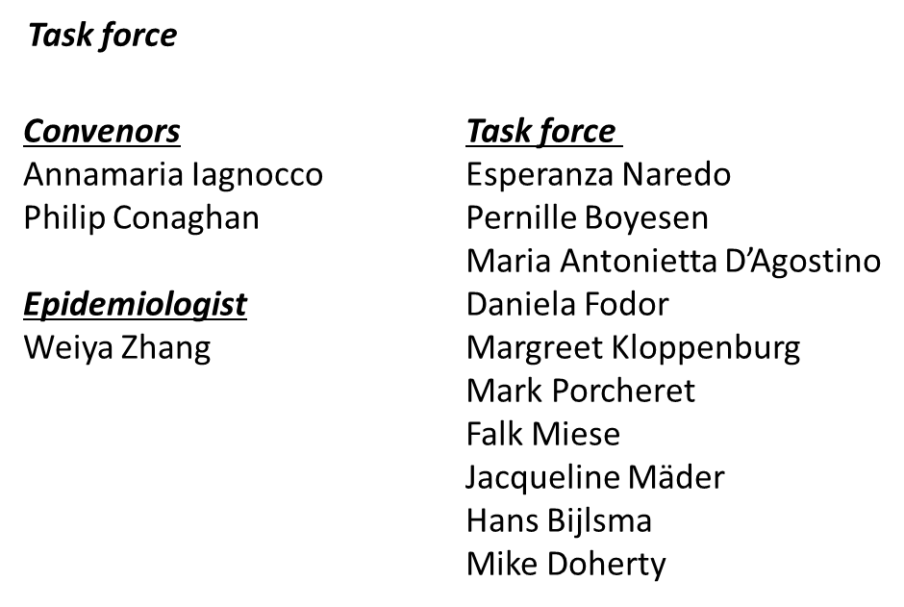
Acknowledgements

