Slide 1
EULAR/EFORT recommendations for management of patients older than 50 years with a fragility fracture and prevention of subsequent fractures
Ann Rheum Dis 2016

Slide 2
Target population: patients older than 50 years with a fragility fracture
Primary research question: how to prevent subsequent fractures in patients older than 50 years with a fragility fracture?
Background: this set of recommendations is based on an initiative of The European League Against Rheumatism (EULAR) and the European Federation of National Associations of Orthopaedics and Traumatology (EFORT).

Slide 3
Slide 2: Methods/methodical approach
Methods: According to the EULAR Standardized Operating Procedures*
Consensual approach
Systematic literature research
Consensual approach
FINAL Recommendations
* van der Heijde et al Ann Rheum Dis 2016,75:3-15

Slide 4
Overarching principles (part one)
First, although both in the acute care phase after the fracture and in the subsequent prevention of secondary fractures, many different medical specialties can be involved, the critical point is not who is taking care of the patient, but that all patients receive optimal care. Obviously, a structured collaboration between health care workers is a prerequisite, reflected in several of our recommendations.
Second, optimal acute fracture care is dependant on the type of fracture and the age, presence or absence of comorbidity and the needs of the patient.
Third, especially in the frail elderly person with a major fracture, an orthogeriatric and multidisciplinary approach is warranted.

Slide 5
Overarching principles (part two)
Fourth, optimal care in the preoperative, operative and postoperative phases all have an important effect on clinical outcome. As a consequence, it is very likely that limited mobility and a poor quality of life in the postoperative phase may be associated with an elevated risk of future fractures.
Fifth, for prevention of subsequent fractures, it is important that in all patients fracture risk should be investigated systematically.
Sixth, for subsequent prevention of fractures in high-risk patients, not only effective and safe drugs should be prescribed, but non-pharmacological treatment options and patient education also need to be considered.

Slide 6
Recommendations for patients with fragility fractures
50 years and older (1)
Fragility fractures should be managed in the context of a multidisciplinary clinical system, guarenteeing adequate preoperative assesment and preparation of patients, including adequate pain relief, appropriate pain relief and surgery within 48 hours of injury.
Level of evidence: IIA | Strength of recommendation: B | Level of agreement: 9,8 (8-10)

Slide 7
Recommendations for patients with fragility fractures
50 years and older (2)
To improve functional outcome, and to reduce length of hospital stay and mortality, orthogeriatric co-management should be provided, especially in elderly patients with hip fracture.
Level of evidence: IA | Strength of recommendation: A | Level of agreement: 9,2 (0-10)

Slide 8
Recommendations for patients with fragility fractures
50 years and older (3)
Appropriate treatment of the fractures in these, often elderly and multimorbid, patients with frail bones, requires a balanced approach with regard to operative versus nonoperative treatment and careful selection of fixation devices and techniques.
Level of evidence: III | Strength of recommendation: C | Level of agreement: 9,3 (7-10)

Slide 9
Recommendations for patients with fragility fractures
50 years and older (4)
Each patient aged 50 years and over with a recent fracture should be evaluated systemically for the risk of subsequent fractures.
Level of evidence: IA | Strength of recommendation: A | Level of agreement: 9,5 (5-10)

Slide 10
Recommendations for patients with fragility fractures
50 years and older (5)
Evaluation of the risk of subsequent fractures includes a review of clinical risk factors, DXA of the spine and hip, imaging of the spine for vertebral fractures and evaluation of fall risk and the identification of secondary osteoporosis, which together predict subsequent fracture risk.
Level of evidence: III | Strength of recommendation: C | Level of agreement: 9,3 (6-10)

Slide 11
Recommendations for patients with fragility fractures
50 years and older (6)
Implementation requires a local responsible lead, that is a person/group that coordinates secondary fracture prevention based on guidelines, liaising between surgeons, rheumatologists/endocrinologists, geriatricians in case of elderly with a hip or other major fracture, and general practitioners.
Level of evidence: IV | Strength of recommendation: D | Level of agreement: 9,1 (6-10)

Slide 12
Recommendations for patients with fragility fractures
50 years and older (7)
An appropriate rehabilitation programme should consist of both early postfracture introduction of physical training and muscle strengthening and the longterm continuation of balance training and multidimensional fall prevention.
Level of evidence: IIA | Strength of recommendation: B | Level of agreement: 9,5 (5-10)

Slide 13
Recommendations for patients with fragility fractures
50 years and older (8)
Patients should be educated about the burden of the disease, risk factors for fractures, follow-up and duration of therapy.
Level of evidence: IV | Strength of recommendation: D | Level of agreement: 9,2 (5-10)

Slide 14
Recommendations for patients with fragility fractures
50 years and older (9)
Non-pharmacological treatment is important in the prevention of fractures in high-risk patients: it includes at least an adequate intake of calcium and vitamin D, stop smoking and limitation of alcohol intake.
Level of evidence: IV | Strength of recommendation: D | Level of agreement: 9,3 (6-10)

Slide 15
Recommendations for patients with fragility fractures
50 years and older (10)
Pharmacological treatment should preferably be based on drugs that have been demonstrated to reduce the risk of vertebral, non-vertebral and hipfractures, and patients should be regularly monitored for tolerance and adherence.
Level of evidence: IB | Strength of recommendation: A | Level of agreement: 9,9 (9-10)

Slide 16
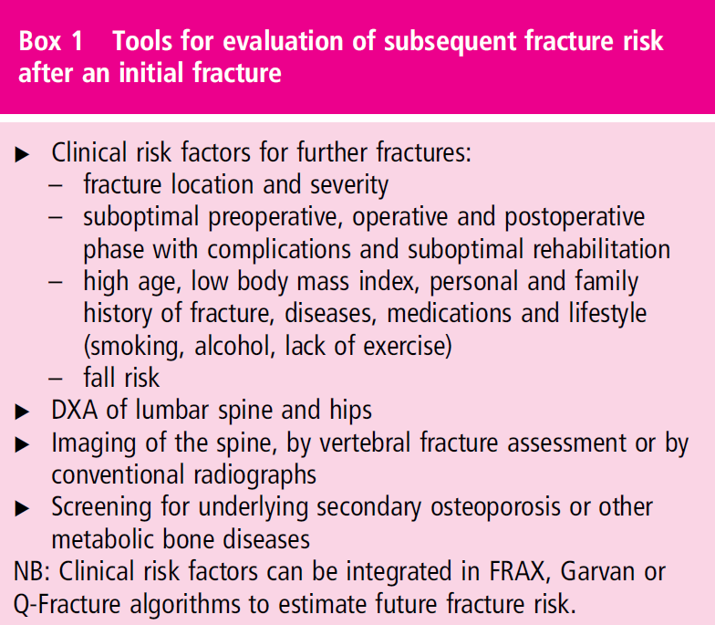

Slide 17

Table 3. Research agenda (part 1)
Factors and interventions that improve the clinical condition of patients with a recent fracture before surgery.
Effects of orthogeriatric assessment on mortality and morbidity in elderly patients with major fractures.
Prevention and treatment of delirium.
Evaluation of the best post-fracture rehabilitation strategies for fragility fractures: intensity, duration and content.
Effects of a complex biopsychosocial interventions on early and long term rehabilitation effects.
Role of muscle loss, sarcopenia and nutrition on recovery following hip fracture, and the role of physical and pharmacologic approaches in managing these deficits.
Initiatives for multi-disciplinary collaboration for secondary fracture prevention.

Slide 18
Table 3. Research agenda (part 2)
What is the long-term effect of FLS and its implementation the adherence to to therapy and reduction of fractures, morbidity and mortality?
‘Real world’ cost-effectiveness of orthogeriatric care and for FLS.
Subsequent fracture prevention of individuals who are not able to visit the FLS, e.g hip fracture patients.
Optimal timing of start and duration of anti-osteoporotic drugs.
Benefits of combining exercise, nutrition, pharmacologic and other intervention strategies.
Optimize strategies for early fall prevention in patients with fragility fractures.
Effects of drugs (anti-resorptive, osteo-anabolic drugs, biologics, NSAIDS ) on fracture healing (delayed or non-union) and on atypical femoral fractures.
Implementation of recommendations.

Slide 19
Lay Summary (1), the surgical part.
In the target population, patients older than 50 years with a fragility fracture, optimal care before, during and directly after the operation, have all an important effect on clinical outcome.
As a consequence, it is very likely that limited mobility and a poor quality of life remaining after the operation, may be associated with an elevated risk of future fractures.
Optimal acute fracture care (operation or plaster) is dependant on the type of fracture and the age, presence or absence of comorbidity and the needs of the patient.
Especially in the frail elderly person with a major fracture, e.g a hip or pelvic fracture, an orthogeriatric and multidisciplinary approach is warranted. In an orthogeriatric ward, a geriatrician collaborates with an orthopaedic surgeon, and with trained nurses in both specialties.

Slide 20
Lay summary (2), prevention of subsequent fractures
For the prevention of subsequent fractures, after an initial fracture, it is important that in all patients 50 years and over, fracture risk should be investigated systematically.
Evaluation of the risk of subsequent fractures includes: a) a review of clinical risk factors, such as age, low BMI, familary osteoporosis, earlier fractures, smoking and immobility; b) Bone mineral density measurement (DXA) of the spine and hip; c) imaging of the spine for vertebral fractures (VFA); d) evaluation of fall risk; e) the identification of other diseases that affect bone strength (secondary osteoporosis). All these factors together predict the subsequent fracture risk.
Non-pharmacological treatment is important in the prevention of subsequent fractures: it includes at least an adequate intake of calcium and vitamin D, prevention of falls, stop smoking and limitation of alcohol intake.
Pharmacological treatment should be used at least 5 years. The first choice are drugs that have been demonstrated to reduce vertebral- and nonvertebral fractures, including hipfractures: weekly oral alendronate and risedronate, zoledronic acid (intravenous once a year), or denosumab (subcutaneous, twice a year)

Slide 21
Slide 18: Acknowledgements
This set of recommendations were initiated by both The European League Against Rheumatism (EULAR) and the European Federation of National Associations of Orthopaedics and Traumatology (EFORT).

