Slide 1
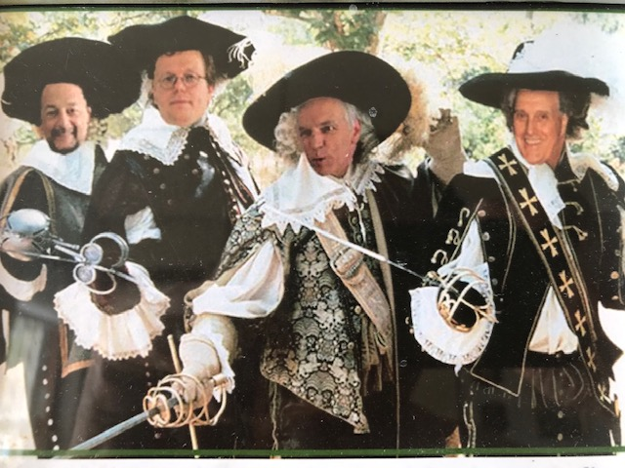
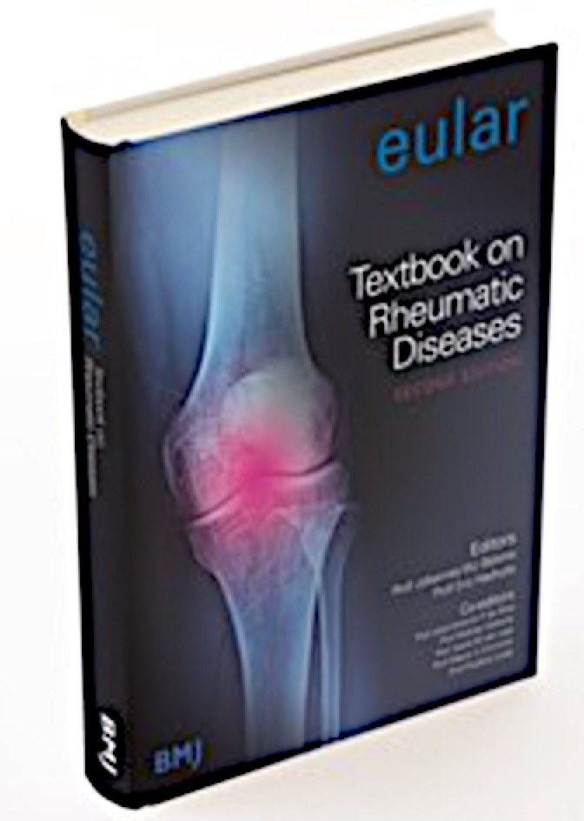
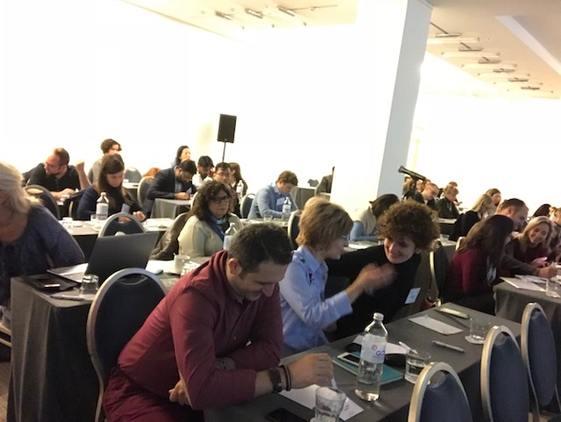
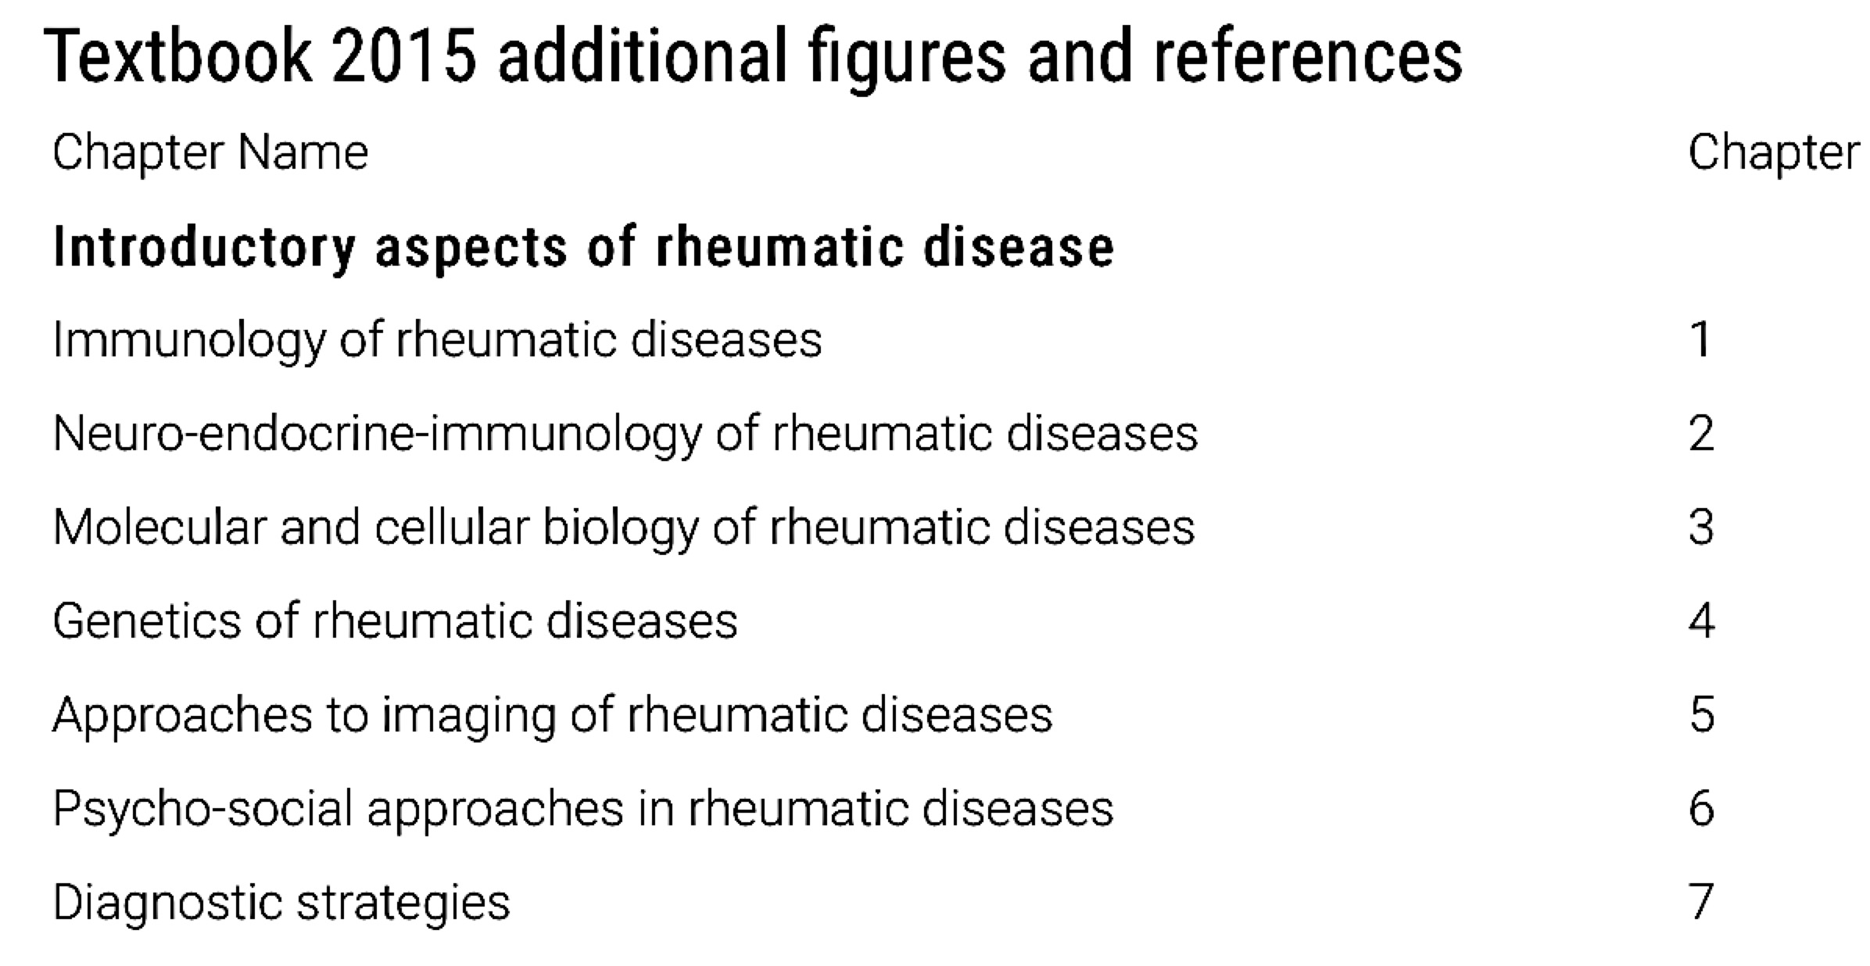
EULAR Study Group on NEUROENDOCRINE IMMUNOLOGY of the RHEUMATIC DISEASES (NEIRD) 2019
NEIRD inside the EULAR programmes and ESoR
The results of the NEIRD Study Group investigations and related publications by its members, are regularly presented (from 1999) and discussed during the EULAR annual meeting at the ESCIR workshop.
Recently the NEIRD has become part of EULAR educational matter and presented in important textbooks of Rheumatology or online courses even under the EULAR patronage and the EULAR School of Rheumatology (ESoR).
In particular the chapter “Neuroendocrine immunology in rheumatic diseases” in the EULAR Compendium on Rheumatic Diseases – TextBook on Rheumatic diseases BMJ (2009 & 2012 & 2015 editions (chapt 50 and 2) Straub RH & Cutolo M. And in the New Primer in RMDs 2017 including the Spanish Edition 2018
Recent research projects/meetings involving EULAR/NEIRD endorsement/contribution and achievements
° Contribution to the EU Horizon 2020 – the Framework Programme for Research and Innovation (2014-2020), Project title funded by EU:
“The Glucocorticoid Low-dose Outcome in RheumatoId Arthritis Study (GLORIA) (project n°634886)” (Leader M. Boers, some membres: JA Da Silva, F Buttgereit, J Rovensky, M Cutolo).
Published: Harm, benefit and costs associated with low-dose glucocorticoids added to the treatment strategies for rheumatoid arthritis in elderly patients (GLORIA trial): study protocol for a randomised controlled trial.Hartman L, Rasch LA, Klausch T, Bijlsma HWJ, Christensen R, Smulders YM, RButtgereit F8, Cutolo M9, Da Silva JAP1, Opris D, Rovenský J, Middelink LM, Lems WF, Boers M. Trials. 2018;1967. doi: 10.1186/s13063-017-2396-3.
° Contribution to the EULAR Task Force Giant Cell Arteritis Registry – (Leader F Buttgereit):
2018 EULAR recommendations for a core data set to support observational research and clinical care in giant cells arteritis
Ehlers L, Askling J, Bijlsma HW, Cid MC, Cutolo M, Dasgupta B, Dejaco C, Dixon WG, Feltelius N, Finckh A, Gilbert K, Mackie SL, Mahr A, Matteson EL, Neill L, Salvarani C, Schmidt WA, Strangfeld A, van Vollenhoven RF, Buttgereit F. Ann Rheum Dis. 2019 Mar 21. pii: annrheumdis-2018-214755.
° Contribution to the NEI Study Group at ACR 2018. Chicago, October 22, 2018. Convention Ctr: Chairs/Speakers: Frank Buttgereit. Georg Pongratz, Maurizio Cutolo. Title: “Introduction to Neuroendocrine Immunology - Sex Hormone Stratification and Clinical Outcomes ”
° Contribution to the XVII Mediterranean Congress of Rheumatology held in Genova (Croatia)12-14 April 2018. Session on NEIRD title “Sun, Vitamin D and autoimmune rheumatic diseases”
° Contribution to the EULAR Postgraduate course, Belgrade (Serbia), 22-25 Oct 2017 Session Title: “Optimizing the use of glucocorticoids in rheumatic diseases”
° Contribution to the NEIRD Endhorsement to the X ISNIM (International Society for Neuro Immuno Modulation) CONGRESS: “Translational NeuroImmunoModulation” Rome 26-28.5.2018: ISNIM “Session 1: Neuroimmunomodulation and autoimmune diseases”.
° Contribution to the 39th EWRR 2019 Workshop from the 28th February to the 2nd March, in Lyon, France.
Presentation TITLE: Sex hormones and autoimmunity.
° Contribution to: ESCEO Conference February 06, 2019, 09:00 am – 01:30 pm La Réserve, Geneva
Alternative treatments for osteoarthritis: stem cells, platelet-rich plasma, autologous chondrocyte transplantation: 10:25: Vitamin D as a treatment for osteoarthritis: what is the current level of evidence? – Maurizio Cutolo
Who we are
Aim of the NEIRD Study Group
The Neuro Endocrine Immune Network (NEI) is the most important communication-system in human body to mantain the health status. NEIRD evaluate the relationships between NEI and RMDs.
The altered interaction between the nervous system, the immune/inflammatory cells and the endocrine system plays an important role in the pathophysiology of autoimmunity.
The involvement of the adrenal steroid hormones in the immune response is fundamental and follow circadian rhythms (NOBEL PRIZE for Medicine 2017).
The nocturnal ability of the NEI system to mount an efficient immune and inflammatory response, with related clinical consequences, is matter of important chronotherapautical approaches with exogenous steroids, in particular with glucocorticoids (GCs). Other important steroid hormones involved in the NEI are the sex hormones and the D hormone (vit D).
Recent Publications involving NEIRD
° Contribution to: "Disease knowledge index" and perspectives on reproductive issues: A nationwide study on 398 women with autoimmune rheumatic diseases. Andreoli L, et al. Tincani A. Joint Bone Spine. 2018 Dec 21. pii: S1297-319X(18)30257-4.
° Contribution to: Disease activity assessment of rheumatic diseases during pregnancy: a comprehensive review of indices used in clinical studies.
Andreoli L, Gerardi MC, Fernandes M, Bortoluzzi A, Bellando-Randone S, Brucato A, Caporali R, Chighizola CB, Chimenti MS, Conigliaro P, Cutolo M, Cutro MS, D'Angelo S, Doria A, Elefante E, Fredi M, Galeazzi M, Gerosa M, Govoni M, Iuliano A, Larosa M, Lazzaroni MG, Matucci-Cerinic M, Meroni M, Meroni PL, Mosca M, Patanè M, Pazzola G, Pendolino M, Perricone R, Ramoni V, Salvarani C, Sebastiani GD, Selmi C, Spinelli FR, Valesini G, Scirè CA, Tincani A. Autoimmun Rev. 2019 Feb;18(2):164-176.
° Compilation: Vitamin D and systemic lupus erythematous: a review of immunological and clinical aspects.
Dall'Ara F, Cutolo M, Andreoli L, Tincani A, Paolino S. Clin Exp Rheumatol. 2018 Jan-Feb;36(1):153-162.
° Compilation: Circadian rhythms and rheumatoid arthritis. Cutolo M. Joint Bone Spine. 2018 Sep 15. pii: S1297-319X(18)30178-7.
° Compilation: Psychoneuroimmunology-developments in stress research. Straub RH, Cutolo M. Wien Med Wochenschr. 2018 Mar;168(3-4):76-84.
Major NEIRD topics
Major topics of the EULAR SG NEIRD during the last academic years (2018-2019) include:
Circadian rhythms (CR) and chronotherapy in RMDs (Circadian Rhythm got Nobel Prize Medicine 2017)
Role/effects and optimisation for the use of glucocorticoids in rheumatic diseases
Epigenetic of Pregnancy and rheumatic diseases
Vitamin D involvement in rheumatic diseases
NEIRD Background – What we do
The EULAR Study Group on NeuroEndocrine Immunology of the Rheumatic Diseases (NEIRD) was already founded in 1998 during the EULAR endorsed First International Conference on Neuroendocrine Immune Basis of the Rheumatic Diseases held in Genova (September 18th-20th, 1998) in order to investigate and disseminate advances on the role of NEI system in Rheumatic Musculoskeletal Diseases (RMD).
The members of the NEIRD organized the following NEIRD International Conferences on “NEIRD and Rheumatic Diseases” (1°, 2nd, 3rd, 4th and 5) held in 1998, 2001, 2005, 2009, 2013 with Proceeding published in special issues of the Annals of the New York Academy of Sciences.
EULAR Postgraduate 2018
The participation to the NEIRD is open
to all membres of EULAR - Committee
The EULAR/ACR members involved from the beginning in the NEIRD Study Group include:
JWJ Bijlsma (NL), RH Straub (D), F Buttgereit (D), L Crofford (US), G Pongratz (D), Boers M (NL), Imrich R (SK), S Capellino (I/D), JAP DaSilva (P), A Doria (I), G Chrousos (G), M Petri (US), M Cutolo (I), A Tincani (I), Andreoli L (I), K Otsa (Est), JM Dayer (S), J Rovensky (SK), P SarziPuttini (I), Smith V (B), Y Shoenfeld (IS), F Atzeni (I), D Jessop (UK), C Pitzalis (UK) M Lockshin (US), I Elenkov (I), M Meroni (I), M Ostensen (N), Meroni PL (I), A Masi (US), R Lahita (US), I McInnes (Sct), T Pincus (USA), B Dasgupta (UK), Salvarani C (I)
Person of contact: Prof. Maurizio Cutolo
Contact: mcutolo@unige.it (+39 335233621)
2018
NEIRD 2013 some participants

