Slide 1
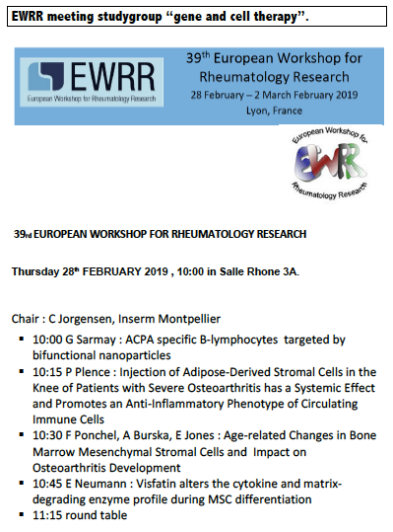
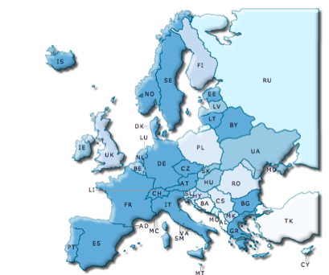






Gene and cell therapy study group 2019
Gene and cell therapy study group
Mission & contribution
Scientific interactions : meeting and collaborative work
cell based therapy : DC mediated therapy in RA, adult stem cell research, iPS, CARTcell
Proof of concept : expertise in experimental arthritis an OA and arthritis models
nucleotide targets , microRNA identified in different cells (MSC, synoviocytes, Tcells, Tregs, monocytes). next step is delivery of small RNA.
Immunomonitoring SOP adapted to cell mediated therapy
Training: The Study group meeting are held during the workshops prior to the openings lecture at the EWRR 2019 in Lyon with approx 22 scientists.
Translationnal research: Clinical programs are ongoing in Europe stimulated by EU partners with strategy using cytokine vaccination, T regulatory cell therapy and dendritic cells (AuToDeCRA), stem cell therapy supported by H2020 : ADIPOA, RESPINE, iPSPINE
Perspectives: The gene and cell therapy study group aims to have two interactive meetings a year, one connected to the EWRR, the second one at the Eular meeting.
Info on EULAR website :
https://www.eular.org/investigative_rheumatology_study_groups.cfm
Lead : C Jorgensen, INSERM, Univ. Montpellier
Goal: the study group dedicated to gene and cell therapy organize scientific meetings, training program and participate to H2020 programs.
The aim of the SGGCT is to build an international network of excellence in cell therapy & to develop novel immune therapy.
Active group of 25 teams, open for scientists or clinicians with special focus to translational clinical research.
Interactions with international societies including IRCS, ISCT, IFATS
Task force : EUROSTEM in EUROPE
Achievements :
Annual EWRR study group
meeting in Lyon EWRR
FOREUM project (coord. D Noel)
New H2020 in 2019 : iPSSPINE
Clinical trials : ADIPOA, RESPINE
REGULATORY
SOP
Guidelines
EATRIS
BIOBANKING
BoneBank, BBMRI
Lubeck Univ/Odense Univ
CELL PRODUCTION
ECELL, DRK, EFS
IRMB
CLINICAL
ECRIN
STEM CELL BIOLOGY, SCAFFOLDS
BASEL MC, IRMB
Contact : christian.jorgensen@inserm.fr

