Slide 1
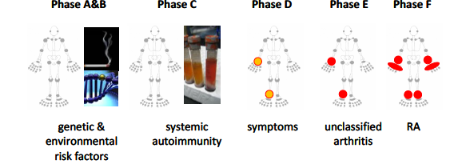
EULAR Study Group for Risk Factors for Rheumatoid Arthritis
Chairs: Andrew Cope, London & Diane van der Woude, Leiden
Goals:
provide a platform for investigators involved in risk factors for RA and “pre-RA”
allow the exchange of ideas and foster new collaborations
inform members of new (unpublished) developments
participate in EULAR guidelines and recommendations applicable to the pre-RA-field
Example of project initiated by study group:
Interested in this study group? Please join us!
Email: dvanderwoude@lumc.nl
Meetings
Year | Venue | Topic
2017 | EULAR | News in pre-RA
2018 | EWRR | Epigenetics and cellular risk factors
2018 | EULAR | Round-up: from B cells to e-health

