Slide 1
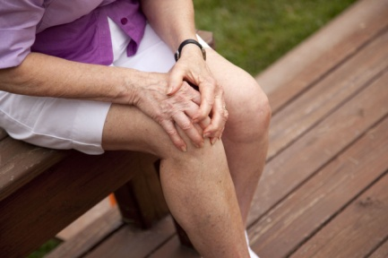

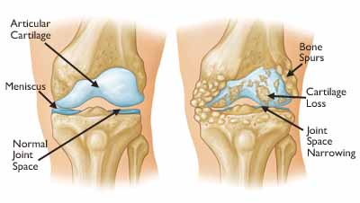
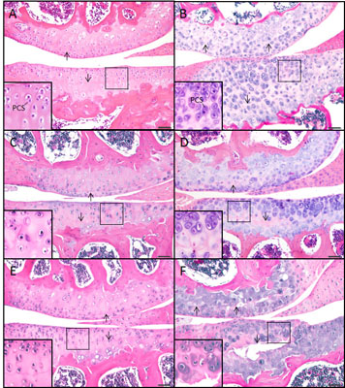
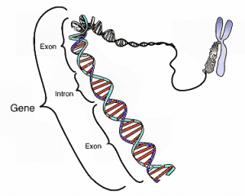

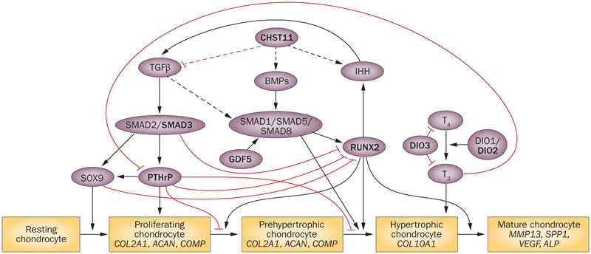


EULAR Study Group on Osteoarthritis
Aim
The purpose of the EULAR Study Group on OA (SGOA) is to encourage wider communication within the EULAR for scientists and clinicians with a specific interest in the etiopathogenesis of OA and to build an international network to facilitate collaboration and to exchange knowledge within Europe. The group aims to promote fundamental and translational research, from molecule to population, on the etiopathogenesis of OA with the ultimate goal to develop effective therapies for OA to diminish the OA-related burden for man and society. The group provides an encouraging and open forum that enables scientist and clinicians to stimulate EU collaborations. The group intends to assemble annually at the EULAR & EWRR meetings and communicates electronically in between meetings as required.
The specific aims of the study group on OA are:
1. To integrate different know-how and skills to study the pathophysiology of the OA disease process
2. To exchange knowledge and to standardize both in vitro and in vivo models used to study OA pathobiology
3. To develop intervention protocols based upon an understanding of and targeting of validated OA disease mechanisms
4. To provide a forum for the OA research community across the EULAR member countries to share ideas and identify priorities
Alter the perception of OA as a simple, inevitable wear and tear disease by health care providers, patients and general public.
For the great enemy of the truth is very often not the lie—deliberate, contrived, and dishonest—but the myth—persistent, persuasive…
John F. Kennedy (1962)
Myths about OA
OA is just wear and tear of cartilage, if you use it tears down, like a tire
OA is just old age, if you get older you get it, inevitable
Nothing can be done for OA, just learn to live with it
Medical imaging predicts how much pain or trouble functioning the person is having
OA patients worry when diagnosed with OA that it is inevitable that they are going to need surgery (5% gets this).
Implications
Myths of wear and tear withholds patients from doing exercises
Resting relieves pain, so patients rest
Inadeqaute use of (pain) medication
- More difficult to get funding (Netherlands 70% of money charity comes from OA patients)
The position of OA as a Rheumatic Disease in the European Rheumatological
community of Rheumatologists.
How is this perception and position, is this how we want it?
If not, how can we change this?
Activities
What is osteoarthritis?
Patient perspective
Scientist perspective
Facilitate national and international funding OA research
ITN project -InflamOAtion
InflamOAtion wants to train a new generation early-stage researchers to perform integrated innovative interdisciplinary and intersectorial research in joint pathology and immunology. This will enable them to cross critical scientific barriers and unravel the role of inflammation in osteoarthritis and to translate knowledge into products and services for economic and social benefit of a growing public health problem.
Contact: Peter.vanderkraan@radboudumc.nl

